Slide 1
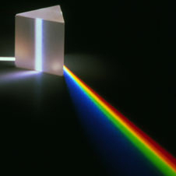
The Nucleus
Stage 1 Physics

Slide 2
A bit of history
450BC – Democritus
Everything is made up of indivisible parts called Atoms
In between is empty space
At the time everyone including Aristotle said he was wrong

Slide 3
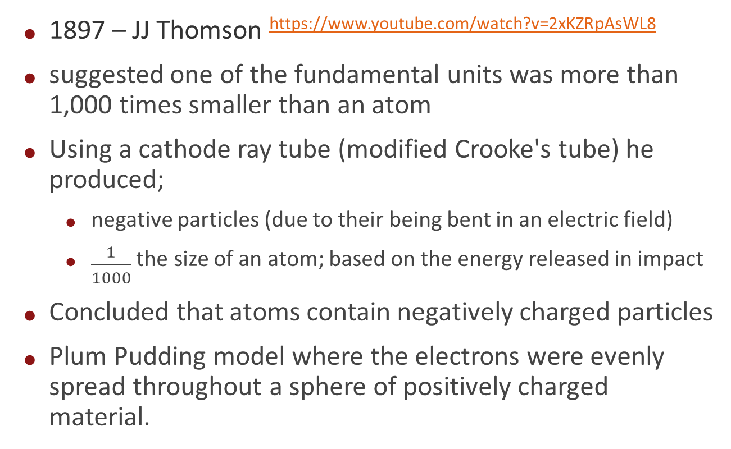
More history – the Electron
1897 – JJ Thomson https://www.youtube.com/watch?v=2xKZRpAsWL8
suggested one of the fundamental units was more than 1,000 times smaller than an atom
Using a cathode ray tube (modified Crooke's tube) he produced;
  negative particles (due to their being bent in an electric field)
  $\frac{1}{1000}$ the size of an atom; based on the energy released in impact
Concluded that atoms contain negatively charged particles
Plum Pudding model where the electrons were evenly spread throughout a sphere of positively charged material.

Slide 4
More history – the Proton
1909 – Rutherford https://www.youtube.com/watch?v=wzALbzTdnc8
Gold foil leaf experiment
Most of atom is empty space
Solid nucleus
Positive Proton identified
Neutron needed to make up total mass, proposed but not found

Slide 5
More history – Atomic model
1915 – Niels Bohr https://www.youtube.com/watch?v=1b9UKTbjj7I
Demonstrated that electrons have specific energy levels associated with them
Proposed orbital model (wrong, but good for chemistry)
Niels’ work is important, more on it later

Slide 6
More history – Atomic model
1932 – James Chadwick
bombarded beryllium with alpha particles releasing a neutral particle with a similar mass to a Proton
Thus, experimental evidence of the Neutron

Slide 7
A bit more history
The neutron was the hardest to find. It has no charge, is fixed within nuclei and only lasts some 14 minutes if separated from the nucleus
Thus we have a solid nucleus of protons and neutrons with electron ‘orbiting’ around it
That should all be firmly in your memory from year 10

Slide 8
Back to Niels Bohr
Atoms can absorb photons of light
Atoms can emit photos of light
BUT the photos are discrete, distinct frequencies for each element (different for each element)

Slide 9
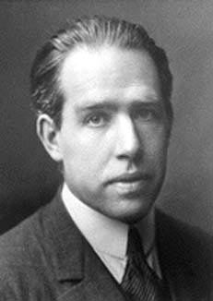
The Bohr model of the Atom
The first glimpse of our current view
Atoms emit discrete frequencies of light
Niels Bohr, using the concept of the photon (Max Planck, Albert Einstein) postulated that electrons exist around the nucleus in discrete energy levels.
These discrete energy levels are called shells in chemistry.
Niels Bohr

Slide 10
What does this mean
If you fire photons of light at an atom
  Only discrete frequencies are absorbed
  Any other frequency simply goes through
But then..
  The absorbed frequencies are re-radiated as photons of the exact same frequency that was absorbed at a later time

Slide 11
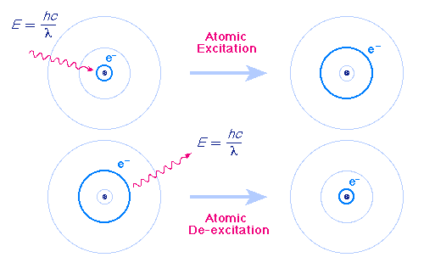
The Bohr model of the Atom

Slide 12
The Atom in pictures, 1
Democritus’ view of atoms
Image courtesy chemtas.com

Slide 13
The atom in pictures, 2
JJ Thomson’s view of the atom
Image courtesy socratic.org

Slide 14
The atom in pictures, 3
Rutherford’s view of the atom
Image courtesy thestargarden.co.uk

Slide 15
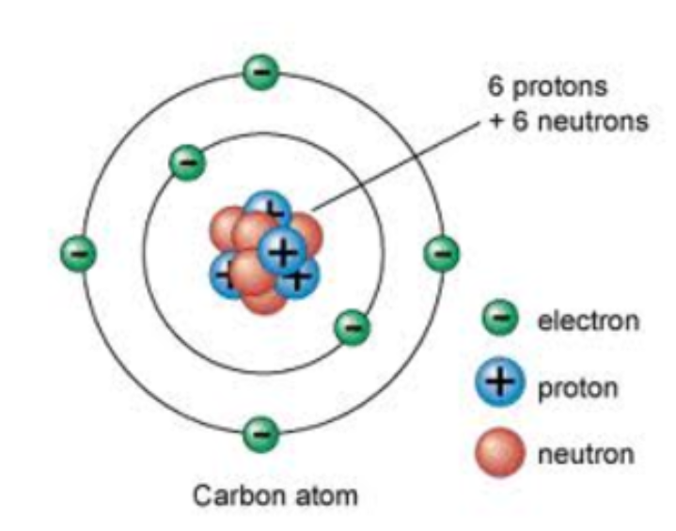
The atom in pictures, 4
Niels Bohr’s view of the atom
Image courtesy timetoast.com

Slide 16
Time for a new view of the atom
On the right is a hydrogen atom
Somewhere a metre below the bottom is the nucleus
Each of the levels; 1,2, ,etc are the energy levels the electrons CAN sit at (they cannot be anywhere else)
In hydrogen the electron would naturally sit on level 1
But if we add some energy we can push the electron up a level

Slide 17
Isotopes
Isotopes are variants of a particular element which differ in neutron number, and consequently in nucleon number. All isotopes of a given element have the same number of protons but different numbers of neutrons in each atom.
Note; nucleon number is the number of protons and neutrons

Slide 18
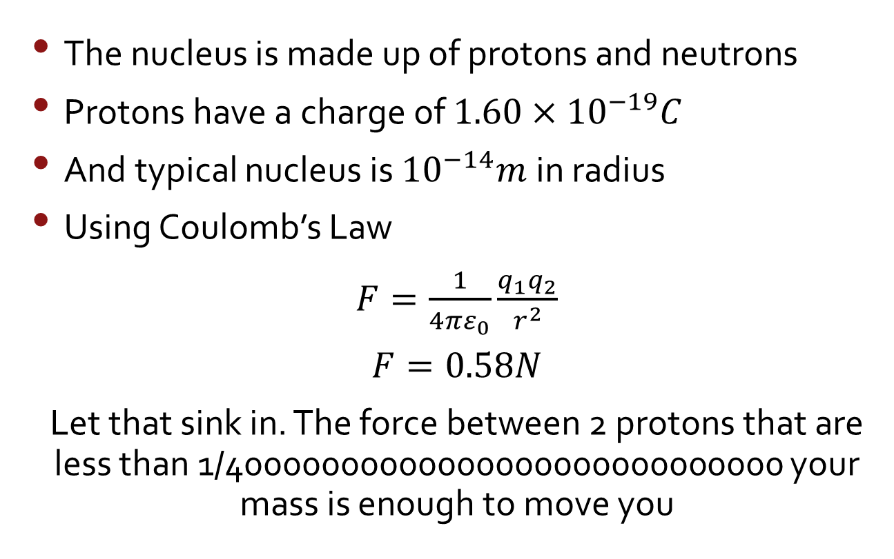
Back to the nucleus
The nucleus is made up of protons and neutrons
Protons have a charge of $1.60×{10}^{−19}C$
And typical nucleus is ${10}^{−14}m$in radius
Using Coulomb’s Law
$F=\frac{1}{4πε_{0}}\frac{q_{1}q_{2}}{r^{2}}$
$$F=0.58N$$
Let that sink in. The force between 2 protons that are less than 1/40000000000000000000000000000 your mass is enough to move you

Slide 19
The electrostatic force between two protons is ENORMOUS
So, something must keep it together
This is the Nuclear Force, a component of the Strong Force

Slide 20
New stuff
The Strong Force has two components;
  The Strong Nuclear Force, which is between Baryons
What’s a Baryon? A Baryon is a particle made up of 3 Quarks
  Protons and Neutrons Baryons
  Protons and Neutrons are also Hadrons (2 or more quarks, in this case 3)
This component of the Strong Force is called the Strong Nuclear Force and is carried by Pions
What’s a Pion? We will get to that

Slide 21
Strong Force, Part 2
As well as being between Baryons (The Strong Nuclear Force)
The Strong Force has a component between Quarks called the Color Force
The Color Force acts between the three Quarks holding them together to make a Baryon
Color Force is Carried by Gluons

Slide 22
Back to Pions
Pions are made up of a Quark and an Anti Quark
Yep, Antimatter
Every fundamental particle has an antimatter particle
So what’s a fundamental particle?
These are;

Slide 23
The Standard Model

Slide 24
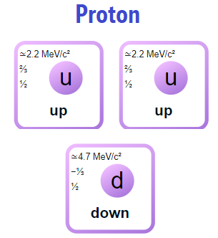
So.. What are Protons and Neutrons?

Slide 25
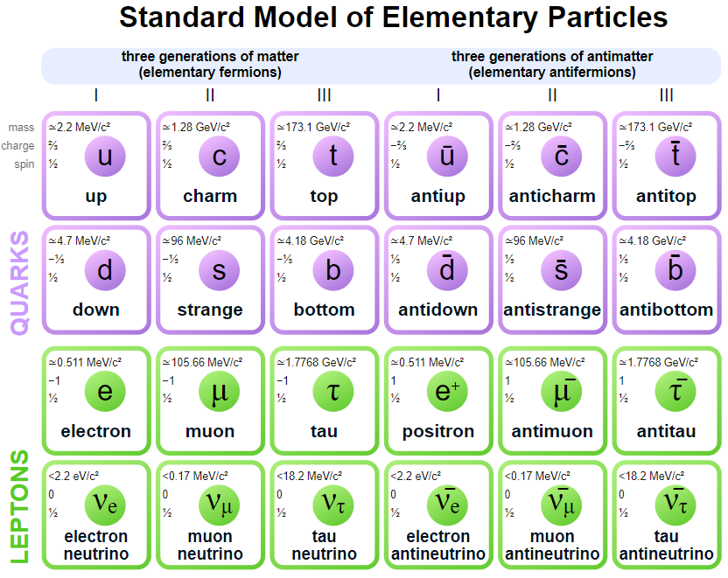
To understand Pions …. every component has an antimatter component

Slide 26
What makes antimatter
In simple terms; it has the opposite of all of the properties of its matter equivalent, except it has the same mass
As a result, when matter and antimatter interact, they annihilate each other becoming the energy of the combined masses
Put another way; since all properties other than mass are opposites, when those properties “disappear”, those properties have been ‘conserved’. Mass becomes energy and thus is conserved

Slide 27
Interesting
Photons (the fundamental unit of light) have anti photons
Since all properties other than energy/mass have to be conserved, the anti photon is created;
  In the same place
  With an identical frequency
  Travelling the opposite direction
  With time travelling in the opposite way
  (note, the time conservation is a mathematical construct)

Slide 28
But, back to the Nuclear Force
Remember, the Nuclear Force is the component of the Strong Force that holds Baryons together
Baryons are 3 Quark particles
Protons and Neutrons and Baryons
And, we said, the force is carried by Pions
Now it is finally time to talk about Pions

Slide 29
Time to blow the mind
Nothing is stable at the fundamental level
Baryons spontaneously emit energy
This energy becomes a pair of Quarks (one matter and one anti matter)
This pair is a Pion
Pions travel from the Baryons they were emitted by to another Baryons

Slide 30
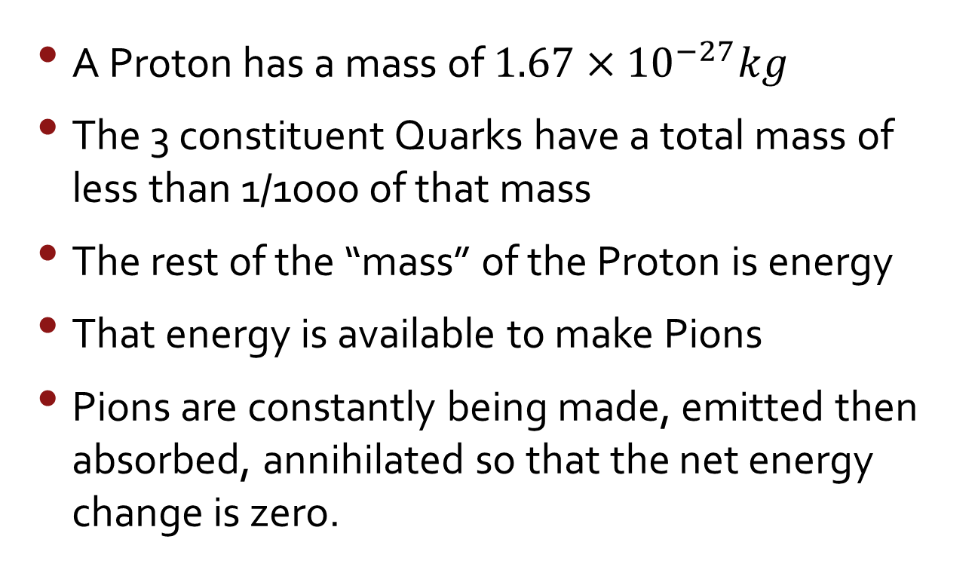
Where did the energy come from?
A Proton has a mass of $1.67×{10}^{−27}kg$
The 3 constituent Quarks have a total mass of less than 1/1000 of that mass
The rest of the “mass” of the Proton is energy
That energy is available to make Pions
Pions are constantly being made, emitted then absorbed, annihilated so that the net energy change is zero.

Slide 31
Pion life
Pion is ‘created’ by a Baryon emitting a quark and an anti quark which then travel to another Baryon, being absorbed by the other Hadron

Slide 32
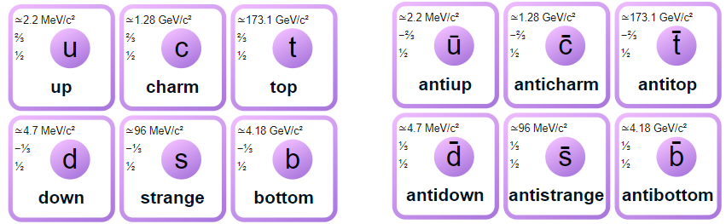
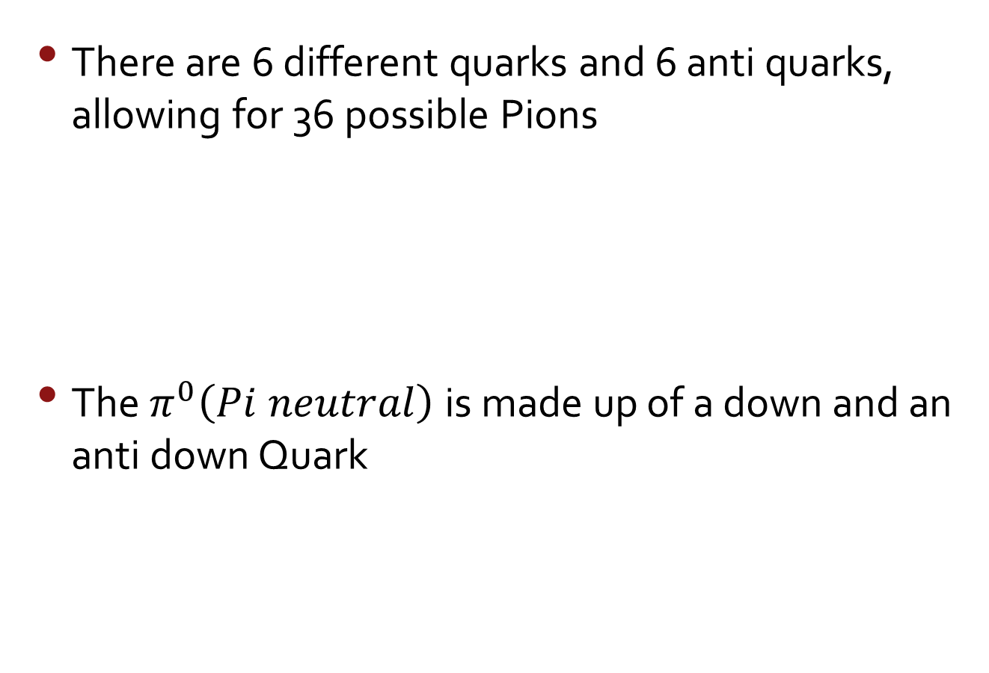
Pion
There are 6 different quarks and 6 anti quarks, allowing for 36 possible Pions
The $π^{0}\left(Pi neutral\right)$ is made up of a down and an anti down Quark

Slide 33
Summary time
Protons have a positive charge
Therefore Protons are electrostatically repelled from each other
The Nuclear Force component of the Strong Force counteracts that repulsion and keeps the Protons together in the nucleus of an atom
The Nuclear Force is “carried” by Pions
Pions are emitted by one Baryon and absorbed by another

Slide 34
Back about 13 slides ago …
Previously we mentioned that the Strong Force also has a component called Color Force that holds the Quarks together to create the individual Hadrons
Strong Force is conveyed by Gluons

Slide 35
Gluon
No mass
No charge
A momentum property called spin
They also carry Color and Anti Color

Slide 36
Okay … what is Color
First, its spelt “color” because it’s a name like ‘Charleen’ and not a term like ‘behaviour’ that is spelt differently in different version of English
Sorry OCD people, I realise that this hurts; tough!
Quarks have a property, related to energy that is called color.
  There are three colors ‘red’, ‘green’, ‘blue’
  Each Quark is ‘charged’ with a color
  A Baryon must be color neutral (have one each of RGB)

Slide 37
Gluons travel between Quarks
Gluons move from one quark to another continually changing the color of the quark it left and the one it is absorbed by to maintain color neutrality.

Slide 38
New Summary
Baryons are made of 3 Quarks
The Quarks have 1 of 3 Colors (red, green, blue)
The Baryon must be Color neutral
Gluons (a fundamental particle) travel between Quarks continually changing Colors to maintain Color Neutrality
This is the Color Force, It is a component of the Strong Force
Gluons carry both a color and an anti color

Slide 39
Full summary
The Strong Force has two components;
The Strong Nuclear Force, which is between Baryons
  This component is carried by Pions
The Color Force acts between the three Quarks holding them together to make a Baryon
  Color Force is Carried by Gluons

Slide 40
The End

