Slide 1
The ABC's (or Alpha, Beta, Gamma) of Radioactivity

Slide 2
Agenda
Definition of Radioactivity and emissions
Discussion of the three most important types of emissions
What do we mean by half-life?
Where is Radioactivity encountered?
Is Radioactivity dangerous?

Slide 3
Expectations
SWBAT state what radioactivity is, where these rays come from, what each ray is made of and state why they are dangerous.
SWBAT identify 4 pioneer scientists who made important contributions to understanding radioactivity
SWABT to explain the meaning of “half-life”.
Student will be asked to find any sources of Radioactivity in his/her environment

Slide 4
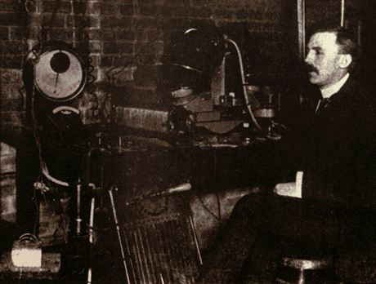
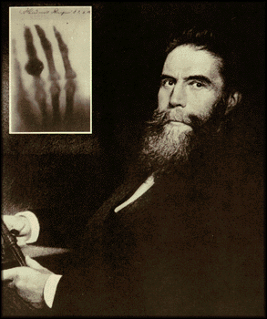
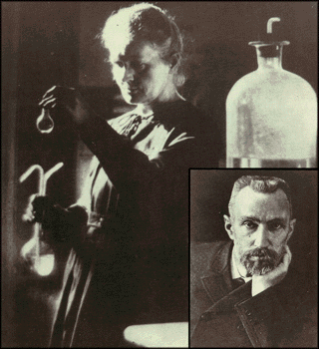
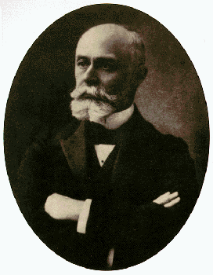
Early Pioneers in Radioactivity
Rutherford:
Discoverer Alpha and Beta rays 1897
Roentgen:
Discoverer of X-rays 1895
The Curies:
Discoverers of Radium and Polonium 1900-1908
Becquerel:
Discoverer of Radioactivity 1896

Slide 5
What do we mean by Radioactivity?
Radioactive decay is the process in which an unstable atomic nucleus loses energy by emitting radiation in the form of particles or electromagnetic waves.
There are numerous types of radioactive decay. The general idea:
An unstable nucleus releases energy to become more stable

Slide 6
Some Key Definitions Before We Move on
Z = The Atomic Number. It’s the Number of Protons in the nucleus of an Atom.
Nucleus: It’s where the Protons and Neutrons are located in an Atom.
Protons: Positively Charged Particles in the Nucleus of the atom. Mass = (approx) 1 AMU
Neutrons: Neutrally charged particles in the nucleus of an atom Mass = (approx) 1 AMU
Mass Number of an atom: Number of Protons + Number of Neutrons in the nucleus of an atom.

Slide 7
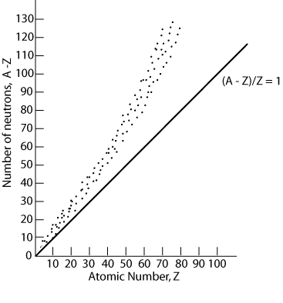
The Nuclear Stability Belt

Slide 8
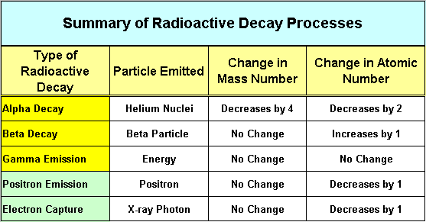
Kinds of Radioactivity
The three main decays are Alpha, Beta and Gamma

Slide 9
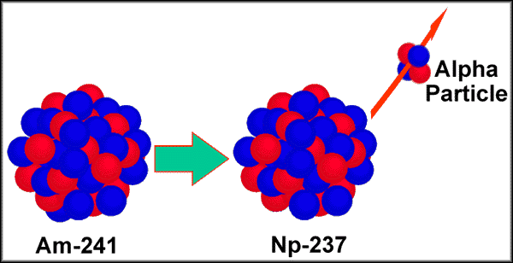
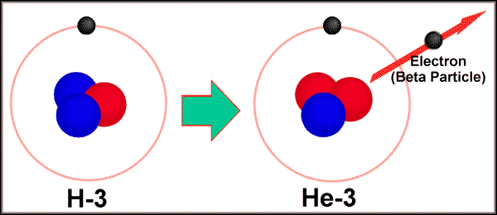
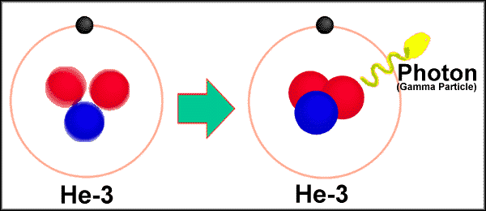
Three Common Types of Radioactive Emissions
Alpha
Beta
Gamma

Slide 10
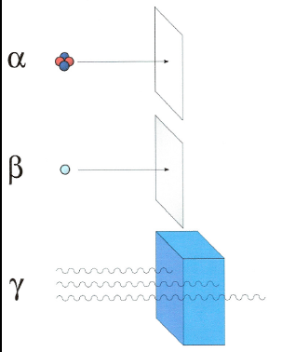
Three Common Types of Radioactive Emissions - Penetrability
Alpha particles may be completely stopped by a sheet of paper, beta particles by aluminum shielding. Gamma rays, however, can only be reduced by much more substantial obstacles, such as a very thick piece of lead.

Slide 11
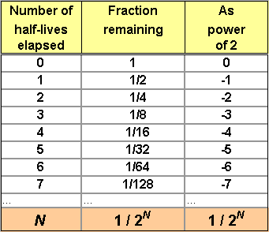
Another Contribution from Rutherford: Half-life of Radioactive Atoms
The half-life of a radioactive substance, is the time required for one half of it to decay.

Slide 12
Sources of Radioactivity
Primordial - from before the creation of the Earth
Cosmogenic - formed as a result of cosmic ray interactions
Human produced - enhanced or formed due to human actions (minor amounts compared to natural)

Slide 13
Where are the Sources of Radioactivity?
Naturally Occurring Sources:
Radon from the decay of Uranium and Thorium
Potassium -40 – found in minerals and in plants
Carbon 14 – Found in Plants and Animal tissue
Manmade Sources:
Medical use of Radioactive Isotopes
Certain Consumer products –(eg Smoke detectors)
Fallout from nuclear testing
Emissions from Nuclear Power plants

Slide 14
Radioactivity – Is it a Health Problem?
The Alpha, Beta and Gamma particles all add energy to the body’s tissues. The effect is called the Ionizing Energy. It can alter DNA.
Even though Alpha particles are not very penetrative if the decaying atom is already in the body (inhalation, ingestion) they can cause trouble.
The Time, Distance and Shielding principle

Slide 15
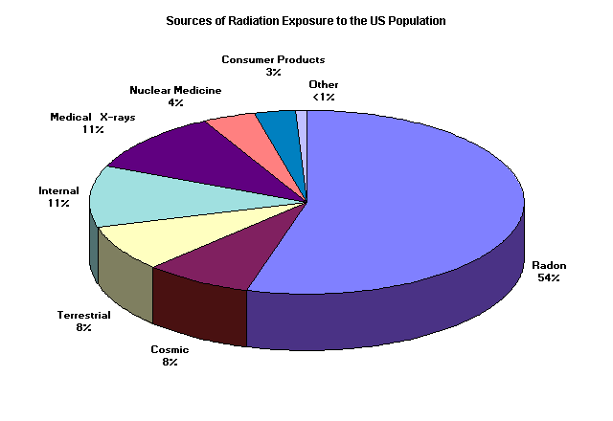
Radiation Exposure to Americans

Slide 16
Summary/Questions
Name three of the science pioneers in the study of Radioactivity.?
Why does a nucleus decay?
Order these emissions from least to greatest penetrability: Gamma, Alpha, Beta.
What is the greatest source of exposure to radioactivity in our everyday lives?
If I tell you that that the half-life of Fellmanium-250 is 10 days, how much would be left after 30 days if I started with 1600 atoms?

Slide 17
Where to Get More Information
http://www.physics.isu.edu/radinf/natural.htm
EPA (Environmental Protection Agency)
Dept of Energy

