Slide 1
Radioactivity and Nuclear Reactions

Slide 2
Part 1 - Radioactivity
What You’ll Learn
What particles make up an atom and its nucleus
How the nucleus is held together
What radioactivity is
The properties of radioactive and stable nuclei

Slide 3
The Nucleus
The atom is made up of protons, neutrons and electrons.

Slide 4
The Nucleus
The atom is made up of protons, neutrons and electrons.
Positively-charged protons and electrically neutral neutrons are located in the nucleus.

Slide 5
The Nucleus
The atom is made up of protons, neutrons and electrons.
Positively-charged protons and electrically neutral neutrons are located in the nucleus.
Each proton has one positive charge or +1 so each nucleus has a positive charge equal to the number of protons that it has.

Slide 6
The Nucleus
The number of protons is called the element’s atomic number.

Slide 7
The Nucleus
The number of protons is called the element’s atomic number.
Atoms contain the same number of protons as negatively-charged electrons.

Slide 8
The Nucleus
The number of protons is called the element’s atomic number.
Atoms contain the same number of protons as negatively-charged electrons.
The electric attraction of opposites pulls the electrons close to the nucleus.

Slide 9
Is the nucleus the largest part of an atom?
Protons and neutrons are packed together tightly so that the nucleus takes up only a tiny part of an atom.

Slide 10
Is the nucleus the largest part of an atom?
Protons and neutrons are packed together tightly so that the nucleus takes up only a tiny part of an atom.
If an atom were the size of a football stadium, its nucleus would be the size of a marble!

Slide 11
Is the nucleus the largest part of an atom?
Protons and neutrons are packed together tightly so that the nucleus takes up only a tiny part of an atom.
If an atom were the size of a football stadium, its nucleus would be the size of a marble!
Despite taking little space, the nucleus contains almost all the mass of the atom.

Slide 12
Is the nucleus the largest part of an atom?
A proton or neutron has about 2,000 times the mass of an electron.

Slide 13
A Model of an Atom

Slide 14
The Strong Force
The force that makes protons and neutrons attract each other and stay together.
100 times stronger than the electric force
Only works when particles are close

Slide 15
How do forces work in a small nucleus?
In a small nucleus, the particles are close together so that the strong force holds the protons and neutrons tightly together.

Slide 16
How do forces work in a large nucleus?
In a large nucleus, the strong force holds together only the particles that are closest to one another.

Slide 17
How do forces work in a large nucleus?
In a large nucleus, the strong force holds together only the particles that are closest to one another.
In a nucleus with many protons, the electric force repels protons that are far apart.

Slide 18
How do forces work in a large nucleus?
In a large nucleus, the strong force holds together only the particles that are closest to one another.
In a nucleus with many protons, the electric force repels protons that are far apart.
This increased repulsive force causes the particles in a large nucleus to be held less tightly than those in a small nucleus.

Slide 19
Radioactivity
When the strong force can hold a nucleus together forever, the nucleus is stable.

Slide 20
Radioactivity
When the strong force can hold a nucleus together forever, the nucleus is stable.
If not, the nucleus becomes unstable and can break apart or decay by emitting particles and energy.

Slide 21
Radioactivity
When the strong force can hold a nucleus together forever, the nucleus is stable.
If not, the nucleus becomes unstable and can break apart or decay by emitting particles and energy.
Large nuclei are more unstable; all with more than 83 protons are radioactive.

Slide 22
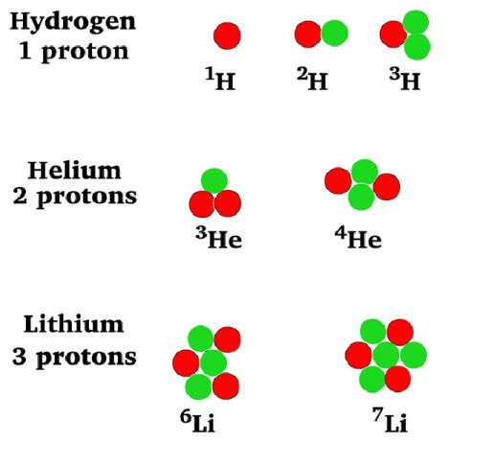
What are isotopes?
Atoms of the same element may have different numbers of neutrons in the nucleus.

Slide 23
What are isotopes?
Atoms of the same element may have different numbers of neutrons in the nucleus.
The atoms of all isotopes of an element have the same numbers of protons & electrons & the same chemical properties.

Slide 24
What makes nuclei unstable?
The ratio of neutrons to protons determines whether a nucleus is stable or unstable.
Small isotopes 1 neutron:1 proton
Large isotope 3 neutrons: 2 protons
Generally, nuclei with too many or too few neutrons compared to the numbers are unstable or radioactive.

Slide 25
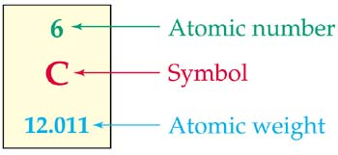
How is a nucleus described?
Atomic number= proton number
Mass number (atomic weight) = protons + neutrons

Slide 26
How is an atom’s information shown?
Scientists use symbols to write information about atoms.
C is the symbol for carbon with 6 protons and 6 neutrons in the isotope C-12. Stable w/ 1:1 ratio

Slide 27
How is an atom’s information shown?
This isotope is carbon-14 with 6 protons and 8 neutrons (14-6); the ratio is 8:6 so this is unstable or radioactive.

Slide 28
Who discovered radioactivity?
In 1896, Henri Becquerel accidentally left pieces of uranium salt in a drawer on a photographic plate. When he developed the plate, he saw an outline of the uranium salt on it. He realized that it must have given off rays that darkened the film.

Slide 29
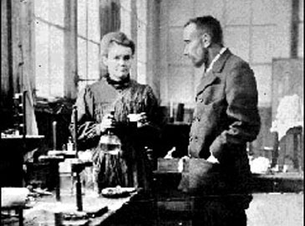
Who discovered radioactivity?
Two years later Marie and Pierre Curie discovered two new elements, polonium and radium, both radioactive.

Slide 30
Who discovered radioactivity?
Two years later Marie and Pierre Curie discovered two new elements, polonium and radium, both radioactive.
It took them >3 years to get 0.1g of radium from several tons of the mineral pitchblende.

Slide 31
Part 2 - Nuclear Decay
What You’ll Learn
How alpha, beta, and gamma radiation are similar and different
What the half-life of a radioactive material is
How radioactive dating is used

Slide 32
Nuclear Radiation
When an unstable nucleus decays, it breaks apart emitting particles and energy as it decays.

Slide 33
Nuclear Radiation
When an unstable nucleus decays, it breaks apart emitting particles and energy as it decays.
Three types of nuclear radiation:
Alpha particles
Beta particles
Gamma radiation electromagnetic wave

Slide 34
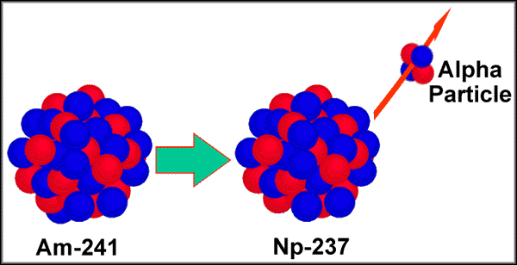
Alpha Particles
An alpha particle is made of 2 protons & 2 neutrons.

Slide 35
Alpha Particles
An alpha particle is made of 2 protons & 2 neutrons.
The decaying nucleus emits an alpha particle ( ⁴₂He) with a mass number of 4 & atomic number of 2.

Slide 36
Alpha Particles
An alpha particle is made of 2 protons & 2 neutrons.
The decaying nucleus emits an alpha particle ( ⁴₂He) with a mass number of 4 & atomic number of 2.
An alpha particle is the same as the nucleus of a Helium (He) atom.

Slide 37
Alpha Particles
Alpha particles have much more mass than beta or gamma radiation
with an electric charge of +2.
Penetrate or pass through matter
Attract negatively charged electrons away from atoms they pass
Lose energy quickly & slow down
Heavier & move more slowly than β or gamma
Sheet of paper can stop alpha particles

Slide 38
How can alpha particles harm you?
Think of alpha particles like bowling balls moving in slow motion – they may not penetrate deeply but they can do lots of damage to whatever they hit.
Released inside the human body they can damage cells causing illness & disease.

Slide 39
How can alpha particles help you?
Smoke detectors work by emitting alpha particles which collide with molecules in the air forming ions that flow within the detector to create an electric circuit. Smoke particles break this circuit causing the alarm to sound.

Slide 40
What is transmutation
After an alpha particle is emitted, the nucleus has 2 fewer protons & neutrons than it had.
Transmutation is the process of changing one element to a different element by the decaying process.
²¹⁰₈₄Po – ⁴ ₂He = ²⁰⁶₈₂Pb
The polonium atom has become a lead atom.

Slide 41
Beta Particles
A second type of radioactive decay, beta radiation, a neutron decays into a proton by emitting an electron (⁰₋₁e). Beta decay is caused by the weak force.

Slide 42
Beta Particles
A second type of radioactive decay, beta radiation, a neutron decays into a proton by emitting an electron (⁰₋₁e). Beta decay is caused by the weak force.
An atom that loses a beta particle undergoes transmutation
¹³¹₅₃I → ⁰₋₁e + ¹³¹₅₄Xe Here iodine becomes xenon.

Slide 43
How can beta particles harm you?
Beta Particles are faster than alpha because they’re smaller & lighter so they penetrate deeper into material they hit.
Pass through paper
Aluminum foil will stop a beta particle
Can damage human cells if released inside the body

Slide 44
Gamma Rays
Gamma radiation is emitted as electromagnetic waves.
Gamma rays are EM waves with the highest frequencies & the shortest wavelength in the EM spectrum.
The symbol for a gamma ray is the Greek letter γ gamma.

Slide 45
Gamma Rays
Have no mass & no charge.
Travel at the speed of light.
Emitted by nucleus when alpha or beta particle is created.
Takes thick blocks of concrete or lead to stop gamma rays.
Cause less damage to cells inside the body than alpha or beta particles.

Slide 46
Radioactive Half-Life
The measure of the time it takes for half of the radioactive nuclei in a sample to decay is called a half-life.
The remaining nucleus is called the daughter nucleus.
Various isotopes decay at different rates.

Slide 47
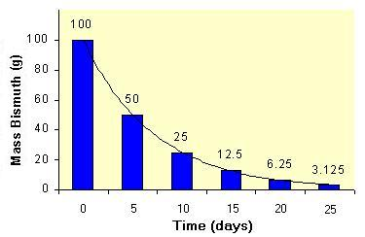
Half-Life
Radioactive bismuth (210Bi) can undergo alpha decay to form the thallium (206Tl) with a half-life equal to 5 days. If we start with 100 g of bismuth in a sealed lead container, after 5 days we will have 50 g of bismuth & 50 g of thallium in the jar. After another 5 days,
One-half of the remaining bismuth will decay & we will be left with 25 g of bismuth & 75 g of thallium in the jar.

Slide 48
Radioactive Dating
Scientists often want to know the ages of rocks & fossils using radioactive isotopes & their half-lives.

Slide 49
Radioactive Dating
Scientists often want to know the ages of rocks & fossils using radioactive isotopes & their half-lives.
The amount of the radioactive isotope in object is measured, then the amount of the daughter nuclei is measured. With these the number of half-lives or age of the object can be calculated.

Slide 50
How is carbon used to date objects?
Carbon-14, with a half-life of 5,730 years is often used to estimate the age of plant & animal remains.

Slide 51
How is carbon used to date objects?
Carbon-14, with a half-life of 5,730 years is often used to estimate the age of plant & animal remains.
CO₂ which plants use in photosynthesis contains C-14 which stays in the same ratio while alive.

Slide 52
How is carbon used to date objects?
Carbon-14, with a half-life of 5,730 years is often used to estimate the age of plant & animal remains.
CO₂ which plants use in photosynthesis contains C-14 which stays in the same ratio while alive.
Once it dies, C-14 decreases as the C-12 increases over time. The ratio estimates ages up to 50,000 years.

Slide 53
How is uranium used to date objects?
Some rocks can be dated using the amount of radioactive uranium isotopes that have decayed into lead.

Slide 54
How is uranium used to date objects?
Some rocks can be dated using the amount of radioactive uranium isotopes that have decayed into lead.
The ratio of the amounts of U isotopes & and their daughter nuclei are compared to estimate the age of the rock.

Slide 55
3 Detecting Radioactivity
What You’ll Learn
How cloud and bubble chambers are used to detect radioactivity
How an electroscope is used to detect radiation
How a Geiger counter measures radiation

Slide 56
Radiation Detectors
Special instruments detect the electric charge of the ions formed by the radioactive particles as they pass through matter.

Slide 57
How does a cloud chamber detect radiation?
A cloud chamber, a rectangular box with transparent sides containing water or ethanol vapor, can be used to detect α or β radiation.

Slide 58
How does a cloud chamber detect radiation?
A cloud chamber, a rectangular box with transparent sides containing water or ethanol vapor, can be used to detect α or β radiation.
A radioactive sample placed in the cloud chamber emits charged α or β particles which pull electrons off atoms in the air leaving a trail of ions.

Slide 59
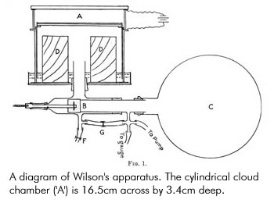
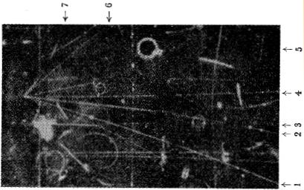
How does a cloud chamber detect radiation?
Vapor condenses around these ions forming small drops along their path.
Beta leave long, thin trails
Alpha leave shorter, thicker trails

Slide 60
What is a bubble chamber?
A bubble chamber contains superheated liquid under high pressure so that it does not boil.

Slide 61
What is a bubble chamber?
A bubble chamber contains superheated liquid under high pressure so that it does not boil.
When a radioactive particle passes through, it leaves a trail of ions that causes the liquid to boil along the ion trail.

Slide 62
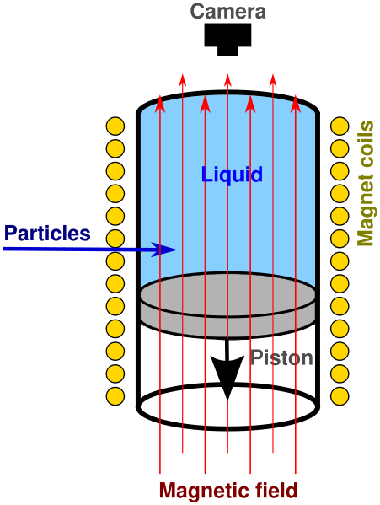
Bubble Chamber
When a charged particle passes through superheated liquid, it leaves a trail of tiny gas bubbles that can be illuminated & photographed. The track of a charged particle can be used to identify the particle & to analyze complex events.

Slide 63
How does an electroscope detect radiation?
Nuclear radiation can cause an electroscope to lose its charge.

Slide 64
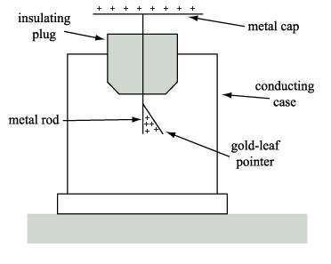
How does an electroscope detect radiation?
Nuclear radiation can cause an electroscope to lose its charge.
Leaves stay apart until their extra negative charges can combine with positive charges creating positive ions in the air.

Slide 65
Tevatron Accelerator

Slide 66
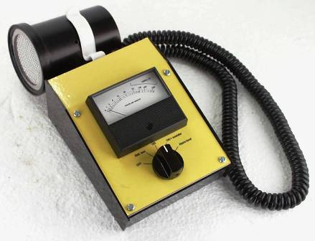
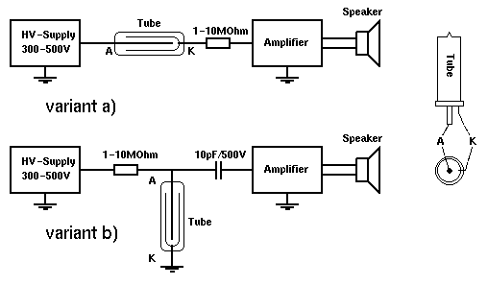
Measuring Radiation
A Geiger counter has a negatively charged Cu tube with a positively charged wire running through it.

Slide 67
Measuring Radiation
The tube is filled with gas at low pressure.
Radiation knocks electrons off the gas which are attracted to the wire producing a current.

Slide 68
Measuring Radiation
An amplifier strengthens the current producing a clicking sound or a flashing light.
The number of clicks or flashes per second tell how strong the radiation is.

Slide 69
Background Radiation
The air, the ground, & even the walls of your home give off radiation in small amounts.

Slide 70
Background Radiation
The air, the ground, & even the walls of your home give off radiation in small amounts.
Radioactive isotopes that occur in nature emit background radiation from rocks, soil, air, bricks, wood, stone, food, water, animals, plants, etc.

Slide 71
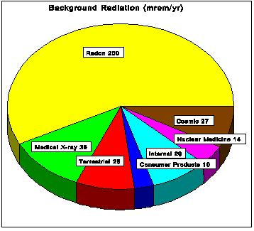
Where does background radiation come from?
The circle graph shows sources received on average by a person living in the US. Decay of U-238 in the soil produces radon gas which can move into houses & basements.
55%
8%
11%
11
4%
8%
3%

Slide 72
Where does background radiation come from?
Cosmic radiation is greater at higher elevations where there is less atmosphere to absorb it.
Background radiation comes from natural processes.
55%
8%
11%
11
4%
8%
3%

Slide 73
4 Nuclear Reactions
What You’ll Learn
What nuclear fission is
What nuclear fusion is
How radioactive tracers can be used in medicine
How nuclear reactions can help treat cancer

Slide 74
Nuclear Fission
1934- Enrico Fermi bombards U nuclei with neutrons.

Slide 75
Nuclear Fission
1934- Enrico Fermi bombards U nuclei with neutrons.
1938- Otto Hahn & Fritz Strassmann split U-235 into smaller nuclei.

Slide 76
Nuclear Fission
1934- Enrico Fermi bombards U nuclei with neutrons.
1938- Otto Hahn & Fritz Strassmann split U-235 into smaller nuclei.
1939- Lise Meitner theorized that splitting occurs when the nucleus becomes so unstable that it splits.

Slide 77
Nuclear Fission
1934- Enrico Fermi bombards U nuclei with neutrons.
1938- Otto Hahn & Fritz Strassmann split U-235 into smaller nuclei.
1939- Lise Meitner theorized that splitting occurs when the nucleus becomes so unstable that it splits.
The process of splitting a nucleus into smaller nuclei- nuclear fission

Slide 78
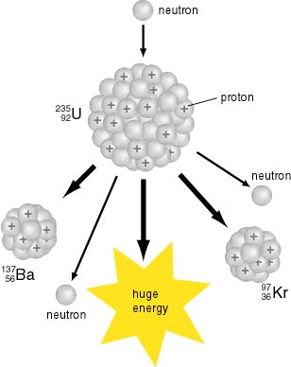
What nuclei can split during nuclear fission?
Only large nuclei like U or plutonium can split apart during nuclear fission.

Slide 79
What nuclei can split during nuclear fission?
U-236 is so unstable that it immediately splits into barium & krypton nuclei, several neutrons & a large amount of energy

Slide 80
How are mass & energy related?
Einstein proposed that mass & energy are related & can be changed from one to the other.

Slide 81
How are mass & energy related?
Einstein proposed that mass & energy are related & can be changed from one to the other.
His special theory of relativity says that energy in joules is equal to mass in kg multiplied by the speed of light squared.

Slide 82
How are mass & energy related?
Einstein proposed that mass & energy are related & can be changed from one to the other.
His special theory of relativity says that energy in joules is equal to mass in kg multiplied by the speed of light squared.
Energy (joules) = mass (kg) X speed of light (m/s)² or E= mc²

Slide 83
What is a chain reaction?
Free neutrons produced by fission can hit other nuclei emitting more neutrons repeating the reaction over and over.

Slide 84
What is a chain reaction?
Free neutrons produced by fission can hit other nuclei emitting more neutrons repeating the reaction over and over.
A series of fission reactions is called a chain reaction.

Slide 85
What is a chain reaction?
Free neutrons produced by fission can hit other nuclei emitting more neutrons repeating the reaction over and over.
A series of fission reactions is called a chain reaction.
An uncontrolled chain reaction releases a huge amount of energy in a short time & requires a critical mass of starting material to produce more reactions.

Slide 86
Nuclear Fusion
Splitting one nucleus of U-235 releases about 30 million times more energy than when one molecule of dynamite explodes.

Slide 87
Nuclear Fusion
Splitting one nucleus of U-235 releases about 30 million times more energy than when one molecule of dynamite explodes.
In a nuclear fusion reaction, two small, light nuclei combine to form one larger, heavier nucleus.

Slide 88
Nuclear Fusion
Splitting one nucleus of U-235 releases about 30 million times more energy than when one molecule of dynamite explodes.
In a nuclear fusion reaction, two small, light nuclei combine to form one larger, heavier nucleus.
Fusion combines nuclei & fission splits them apart.

Slide 89
How are temperature & fusion related?
How can two nuclei get close enough to combine?

Slide 90
How are temperature & fusion related?
How can two nuclei get close enough to combine? They must be moving very fast.

Slide 91
How are temperature & fusion related?
How can two nuclei get close enough to combine? They must be moving very fast.
All nuclei positively charged
Thus repel each other

Slide 92
How are temperature & fusion related?
How can two nuclei get close enough to combine? They must be moving very fast.
All nuclei positively charged
Thus repel each other
KE must overcome electric force to push them close enough to combine
KE increases as temperature increases

Slide 93
How are temperature & fusion related?
How can two nuclei get close enough to combine? They must be moving very fast.
All nuclei positively charged
Thus repel each other
KE must overcome electric force to push them close enough to combine
KE increases as temperature increases
Temp must be millions of °C like Sun & other stars

Slide 94
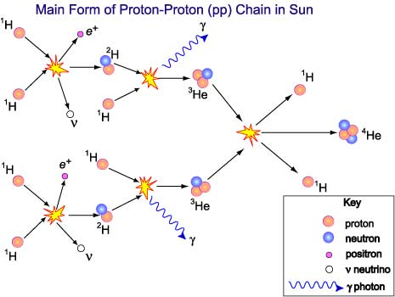
How does the Sun produce energy?
The Sun, made mostly of H produces its energy by fusion of H nuclei
2 protons (H-1) fuse to make a H isotope (H-2); then H-1 + H-2 form an isotope of He-3.

Slide 95
How does the Sun produce energy?
To complete the process, 4 H nuclei combine into 1 He nucleus during which a small amount of matter changes into a huge amount of energy.

Slide 96
Fusion on the Sun
The heat & light Earth receives comes from this process.
About 1% of the Sun’s hydrogen has been changed into energy.
Sun has enough H to continue fusion reactions for another 5 billion years.

Slide 97
Using Nuclear Reactions in Medicine
A tracer is a radioactive isotope used to find or keep track of a molecule as it moves through your body.

Slide 98
How are iodine tracers used?
If the thyroid gland in your neck is not working properly, you get sick. The radioactive isotope I-131 is used to see if the thyroid is working properly. The I-131 decays giving off gamma rays which can be detected.

Slide 99
How can cancer be treated with radioactivity?
Radiation can be used to stop some cells from growing into tumors.

Slide 100
How can cancer be treated with radioactivity?
Radiation can be used to stop some cells from growing into tumors.
Sometimes a radioactive isotope can be placed inside or near a tumor; other times, tumors can be treated from outside the body.

Slide 101
How can cancer be treated with radioactivity?
Radiation can be used to stop some cells from growing into tumors.
Sometimes a radioactive isotope can be placed inside or near a tumor; other times, tumors can be treated from outside the body.
The radiation emitted when particles decay can turn nearby atoms into ions.

Slide 102
How can cancer be treated with radioactivity?
If a source of radiation is placed near cancer cells, atoms in those cells can be ionized such as atoms in DNA or RNA which can stop the tumor from growing or even kill it.

Slide 103
How can cancer be treated with radioactivity?
If a source of radiation is placed near cancer cells, atoms in those cells can be ionized such as atoms in DNA or RNA which can stop the tumor from growing or even kill it.
Because cancer cells grow quickly, radiation affects them more than other cells. Patients receiving radiation suffer side effects when it ionizes healthy cells.

Slide 104
Complete the Venn diagram by listing one thing that fission & fusion have in common, one thing that applies only to fission, & one thing that applies only to fusion,
Fission
Both
Fusion

Slide 105
Complete the Venn diagram by listing one thing that fission & fusion have in common, one thing that applies only to fission, & one thing that applies only to fusion,
Fission
Both
Fusion
Reactions produce energy
2 small, light nuclei combine to form one larger, heavier nucleus
Process of splitting a nucleus into smaller nuclei

