Slide 1
Forces
Stage 1 physics

Slide 2
Physics
Aristotle said a bunch of stuff that was wrong. Galileo and Newton fixed things up, sort of. Then Einstein said they were wrong. Then we sort of fitted it together except we don’t quite understand; small things, big things, hot things, cold things, fast things, heavy things, dark things or turbulence. But we sort of have time sussed.

Slide 3
Onward
On or near the surface of the earth at “normal” speeds and temperatures, “normal” things can be described using Newtonian Mechanics
Thus we will start our study looking at normal stuff in everyday situations – except there is no friction and everything is considered a point (has no dimensions), but otherwise perfectly normal
Who am I kidding – you chose physics – nothing is normal

Slide 4
Force changes motion
You are racing through Gotham city in the Batmobile. Keeping your foot on the accelerator, you tear around a tight corner between two buildings.
Suddenly you find your shoulder pressing against the side of the car – a force
But where does that force come from? Your speed has not changed

Slide 5
Newton’s First Law (N1L)
In our universe, everything ‘wants’ to go in a straight line
‘linear’
Properties are conserved in a straight line;
Energy
Momentum
Any object that is not moving in a straight line is moving under the influence of a force

Slide 6
Big think
Earth moves around the sun, which moves around a black hole

Slide 7
Inertia
a property of matter by which it remains at rest or in uniform motion in the same straight line unless acted upon by some external force (Merriam Webster Dictionary)

Slide 8
Newton’s Second Law (N2L)
You have seen it many times as
$$\vec{F}=m\vec{a}$$
To calculate the motion of objects we use it as
$$\vec{a}=\frac{\vec{F}}{m}$$
But Newton actually said
$$\frac{∆\vec{p}}{∆t}=\vec{a}$$

Slide 9
$$\vec{p}$$
Momentum
Momentum is a linear property of all moving objects
Even light, which has no mass, displays momentum
For a ‘normal’ object $\vec{p}=m\vec{v}$
Momentum vs Inertia?
Momentum is a calculatable / measurable quantity
Inertia is a concept (without an equation)

Slide 10
Quick discussion
Newton was actually 400 years ahead of his time
Newton proposed that light was a particle, this was rejected by other physicists at the time, however, the important point is that Newton was not looking for ways to describe ‘massless’ particles
But … light is massless and light has momentum, so, hundreds of years before the debate on the nature of light even got close to being settled, Newton’s law allowed for its inclusion in motion calculations

Slide 11
Newton’s Third Law (N3L)
The one that is most regularly presented incorrectly
A good way to remember it is as the “sore bottom law”
When you sit on a seat for long enough you get a sore bottom
Is your bottom pushing down on the seat?
Is the seat pushing up on your bottom?
Is the “push” the same in each direction?

Slide 12
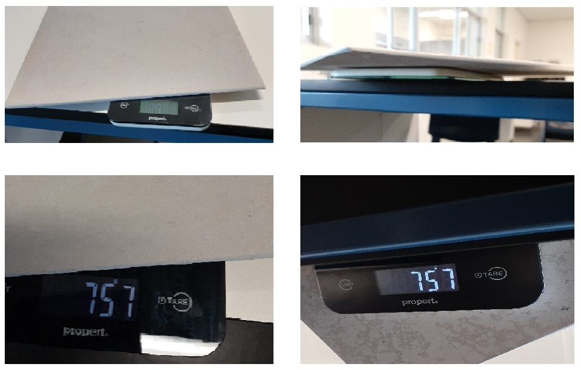
That’s N3L
Whenever something is pushed, the push back must be the same

Slide 13
Gravity
Everything with mass attracts other things with mass
Gravity works over enormous distances

Slide 14
Newton’s Universal Law of Gravitation
$$F=\frac{Gm_{1}m_{2}}{r^{2}}$$
Where
$F is the force of gravity between two objects$
$G is the universl gravitational constant$
$6.67×{10}^{−11}Nm^{2}kg^{−2}$
$m_{1}and m_{2} are the masses of the two objects$
$r is the distance between the two masses$

Slide 15
Your weight
Your weight is the result of your mass being acted on by the mass of the Earth
It is
$$F=\frac{Gm_{1}m_{2}}{r^{2}}$$
You can calculate that force using your mass, the mass of the Earth, the distance between the centre of the Earth and the centre of you

Slide 16
Lets do it …
$$m_{e}=5.97×{10}^{24}kg$$
$$m_{m}=82.0kg$$
$$r=6.37×{10}^{6}m$$
$$G=6.67×{10}^{−11}Nm^{2}kg^{−2}$$
$$F=\frac{6.67×{10}^{−11}×5.97×{10}^{24}×82.0}{{6.37×{10}^{6}}^{2}}$$
$$=805N$$

Slide 17
So, how fast do I fall with gravity (N2L)
$$\vec{a}=\frac{\vec{F}}{m}$$
$$\vec{a}=\frac{805}{82}$$
$$=9.81ms^{−2}$$

Slide 18
Quick algebra
Why does everything fall at $9.80ms^{−2}$
$\vec{a}=\frac{\vec{F}}{m_{m}}$ and $F=\frac{Gm_{e}m_{m}}{r^{2}}$
$$\vec{a}=\frac{\frac{Gm_{e}m_{m}}{r^{2}}}{m_{m}}$$
$$\vec{a}=\frac{\frac{Gm_{e}m_{m}}{r^{2}}}{m_{m}}$$
$$\vec{a}=\frac{Gm_{e}}{r^{2}}$$
‘because you don’t matter’

Slide 19
aside
This is why all satellites have a simple relationship between speed and altitude.
Every satellite at a specific altitude has the same speed.
But … more on that later

Slide 20
Back to gravity
Everything in freefall near the surface of the Earth falls at $9.80ms^{−2}$
Brian Cox gravity video https://www.youtube.com/watch?v=E43-CfukEgs

