Slide 1
Radioactivity
SACE Stage 1 Physics

Slide 2
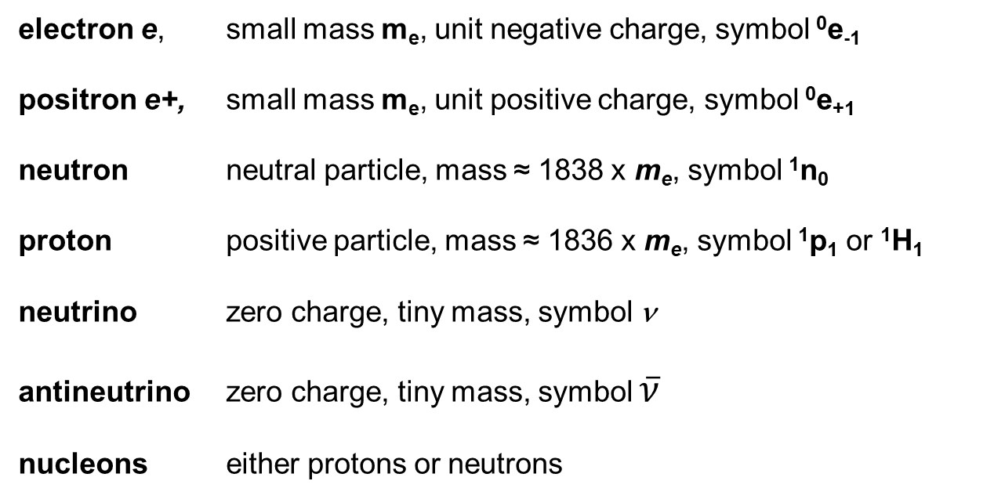
Particles
electron e, small mass m_{e}, unit negative charge, symbol ⁰e₋₁
positron e+, small mass m_{e}, unit positive charge, symbol ⁰e₊₁
neutron neutral particle, mass ≈ 1838 x m_{e}, symbol ¹n₀
proton positive particle, mass ≈ 1836 x m_{e}, symbol ¹p₁ or ¹H₁
neutrino zero charge, tiny mass, symbol ν
antineutrino zero charge, tiny mass, symbol $\overline{ν}$
nucleons either protons or neutrons

Slide 3
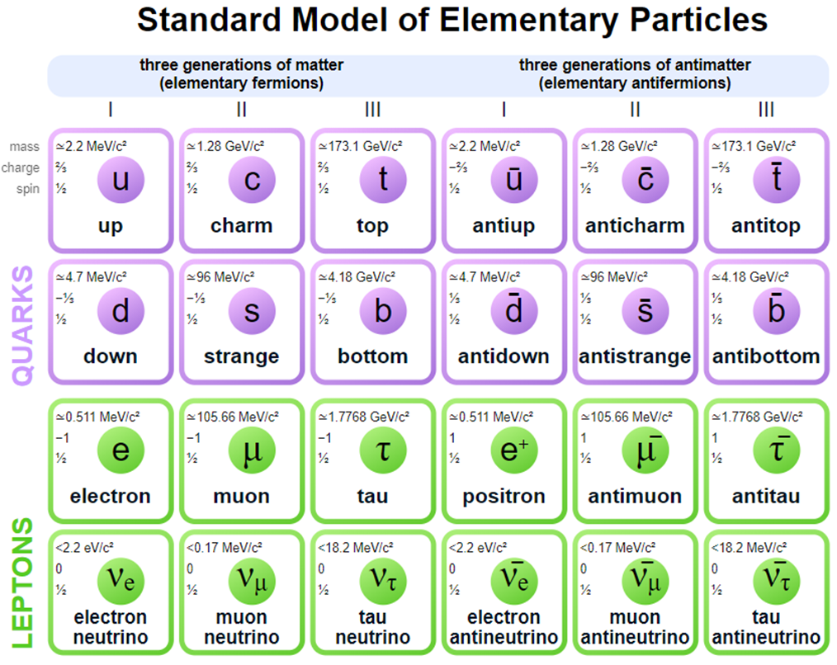
Or

Slide 4
Atoms
Atomic number Z;
= number of protons in nucleus,
= position of atom in periodic table,
= number of electrons in an atom (neutral).
Mass Number A,
= number of nucleons in nucleus
The isotopes of a given atom have nuclei with the same number of protons but differing numbers of neutrons.
All isotopes of a given element behave chemically in the same way -
they simply differ in mass.
Isotopes have different physical properties – makes sense, after all physics is all about collisions.

Slide 5
Nuclides
A nuclide is a particular nucleus with specified values of both Z and A.
hydrogen (light) contains 1 proton . ¹H₁
hydrogen (heavy) or deuterium (deuteron) contains ²H₁ (1 proton and 1 neutron)
hydrogen (heavier) or tritium, contains ³H₁ (1 proton and 2 neutrons)
are all different nuclides of hydrogen.
Nuclei can be either stable or unstable.

Slide 6
Nuclides
A stable nucleus does not disintegrate in any way unless given extra energy.
An unstable nucleus will disintegrate spontaneously either by emitting
α-particles ( 2P and 2 N) or
β-particles (electrons) or
β+ particles (positrons).

Slide 7
Stable and Unstable Nuclei
Naturally occurring isotopes may be either unstable or stable.
For low atomic number nuclei, stable nuclei usually have approximately the same number of protons (Z) as they have of neutrons.
ie N = A - Z = number of neutrons in the nucleus ^{A}X_{Z.} (X – any element)
= Z
A = 2 x Z

Slide 8
Stable and Unstable Nuclei
Nuclei like this are,
²H₁ - Deuteron
⁴He₂ - Helium
¹²C₆ - Carbon
¹⁶O₈ - Oxygen
This 2:1 proton-nucleon ratio holds till Z= 20 (approximately)

Slide 9
Stable and Unstable Nuclei
As the atomic number of a nucleus increases, the repulsive forces between protons increases (protons are positively charged and therefore repel each other). To overcome this for elements with Z>20, stable nuclei have more neutrons than they have protons. The neutrons occupy space, separate the protons somewhat and hence dilute (decrease) the repulsive Coulomb force between protons.
n
n
p
n
n
n
p
x
n
n
n
n
n
n
p
Neutrons added here are too far away to exert much nuclear force on the proton at x.
n
n

Slide 10

The NZ Graph
160
150
140
130
120
Number of neutrons
N = A-Z
110
110
90
80
Most stable isotope
Less stable isotopes
Unstable, decay quickly after production
Note, Lead Z=82 is the largest “stable” element
70
60
50
Z = N
40
30
20
10
0
10
20
30
40
50
60
70
80
90
100
110
Number of protons Z

Slide 11
Types of Decay of Unstable Nuclei
REGION A: Z = N Nuclear force acts equally well on each of these nucleon types.
REGION B: Tendency for nuclides to have more neutrons than protons to balance out repulsive and attractive forces.
REGION C: Z > 83 (₈₂Pb is lead).
Excess neutrons not sufficient to balance forces and nuclides of Z > 82 and are unstable and will decay.
N
C
Unstable
≈130 - 160
N = Z
B
A
≈ 90 - 110
Z

Slide 12
Types of Decay of Unstable Nuclei
4 methods that unstable nuclei can decay
Alpha (α) decay in which α particles (i.e. ⁴He₂ nuclei) are emitted from the unstable nuclei. Occurs when Z>83.
Beta minus (β⁻) decay in which electrons ⁰e₋₁, are emitted. Occurs when nucleus N/Z plot lies above the line of stability.
Beta plus (β⁺) decay in which positrons ⁰e₊₁, are emitted, occurs when N/Z plot lies below the line of stability.
Spontaneous fission in which the nucleus splits into two parts.

Slide 13
Alpha Decay – ⁴He₂
The general α-decay equation →
X is called the parent nucleus, Y is called the daughter nucleus.
Eg,

Slide 14
Alpha Decay – ⁴He₂
Both ²³⁸U₉₂ and ²³⁴Th₉₀ have atomic number > 82 and are therefore unstable.
Proton neutron ratio of Uranium and Thorium,
For ²³⁸U₉₂,
For ²³⁴Th₉₀,
Thorium is more unstable than Uranium, therefore more energy must be released and this is done by a β- decay ( γ-ray photon >0.5 MeV). This reduces the N/Z ratio and the daughter nucleus becomes more stable.

Slide 15
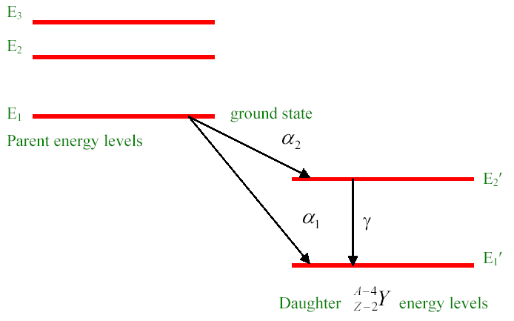
Alpha Decay – ⁴He₂
Nuclei have discrete energy levels, just like atoms.
When an α-particle is emitted the daughter nucleus is often excited. i.e. it is in an energy state above the lowest (ground) state.
Daughter nucleus is usually in an excited state also and must release energy to become stable.
ΔE for nuclide state are greater than the ΔE for atomic energy levels, hence γ-rays have more energy than their counterpart.

Slide 16
Beta Minus Decay - β⁻
Occurs only when a nucleus has an excess of neutrons.
Anti-neutrino
is an antimatter particle with very high energy, tiny mass and travels near the speed of light.
Only interacts with matter with The Weak Force, very difficult to detect but has been verified experimentally.
Must exist to conserve momentum in the collision and energy and the β⁻ is emitted with a range of energies.

Slide 17
Beta Minus Decay - β⁻
General β⁻ decay process,
The mass number of daughter = that of its parent but it has a greater atomic
number. The neutron proton ratio is decreased.
After β⁻ decay occurs the daughter nucleus may be left in an excited state so that
the β⁻ emission is followed quickly by the emission of a γ-ray photon.

Slide 18
Beta Plus Decay - β⁺
This occurs when the parent nucleus has too many protons. A proton is converted into a neutron plus a positron and a neutrino.
The general equation is therefore:
An example is

Slide 19
Beta Plus Decay - β⁺
The positrons (β+ particles) emitted have a range of energies as do β- particles and again, the daughter may be left excited and can decay by γ-ray emission to the ground state.
When a positron appears it disappears fast! There are many free electrons in the environment and when e+ meets e- they annihilate and produce 2 γ-rays.
Each emitted γ has 0.51 MeV of energy. These γ rays are called "annihilation radiation".

Slide 20
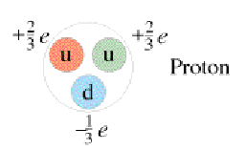
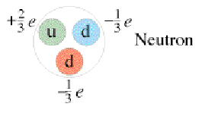
The Composition of Nucleons
Protons and neutrons are not fundamental particles. They are made up of 3 fundamental particles called QUARKS.
Two main types of quarks, UP → +2/3e and DOWN → -1/3e
Net charge +1
Net charge 0

Slide 21
The Composition of Nucleons
There are other properties of quarks called charm c, strange s, top t and bottom b.
There are also anti-quarks.
Quarks, electrons and neutrinos are elementary particles.
It follows from the above that in β decay the conversion of a proton to a neutron or vice versa results when an up quarks changes to a down quark or vice versa.

Slide 22
Half-life (λ) Activity
A radioactive substance is one in which the nucleus is inherently unstable and decays by α or β emission.
The number of radioactive nuclei in a sample of given isotope varies exponentially with time.
Ie – N₀ = the original number of radioactive nuclei at time 0
And N_{t} = the number left after time t
The activity of the sample at any instant will be decreasing with time.

Slide 23
Half-life (λ) Activity
The Half Life (λ) of a substance is the time taken for half of the substance to decay.
The unit of activity of a radioactive substance is the bequerel (Bq) where:
1Bq = 1 decay per second
(Note: Activity = the number of decays per second.)

Slide 24
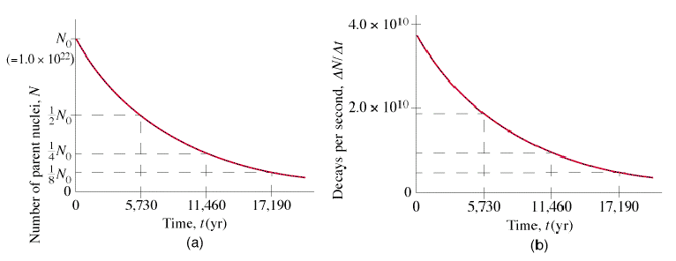
Half-life (λ) Activity
Activity at time t is proportional to N_{t} where the constant of proportionality
depends on the particular isotope being considered.
Decay of Carbon - 16

Slide 25
Half-life (λ) Activity
Example: A sample of ¹³N₇ in the laboratory having a half- life of 600 seconds. contains 7.0 x 10¹⁶ nuclei. How many nuclei will be left after 2400 seconds have elapsed?
4 x 600 → four half-lives.
Time | Atoms | No. of λ
0 | 7.0 x 10¹⁶ | 0
600 | 3.5 ξ 10¹⁶ | 1
1200 | 1.75 ξ 10¹⁶ | 2
1800 | 8.8 ξ 10¹⁵ | 3
2400 | 4.4 ξ 10¹⁵ | 4
i.e., 4.4 x 10¹⁵ atoms are left or 1/2⁴ = 1/16 of the number in the original sample.

Slide 26
Half-life (λ) Activity
Note that RADIOACTIVITY IS A RANDOM PROCESS and has a constant probability for any particular radioactive nucleus.
The half-life is greater for smaller decay probabilities.
ie long lived isotopes such as ²³⁸U₉₂ where λ = 4.5 x 10⁹ years have low decay probabilities while short lived isotopes ¹³¹I₅₃ probabilities the half life being only 8.0 days.
n = number of half lives
N₀ = original amount

Slide 27
Example
The table below records the count rate for a radioactive source. Plot a graph of count rate against time. Find the half life of the source and determine the expected activity after 6 half-lives.
Time (mins) | 0 | 1 | 2 | 3 | 4 | 5
Counts per second | 100 | 59 | 34 | 20 | 12 | 7

Slide 28
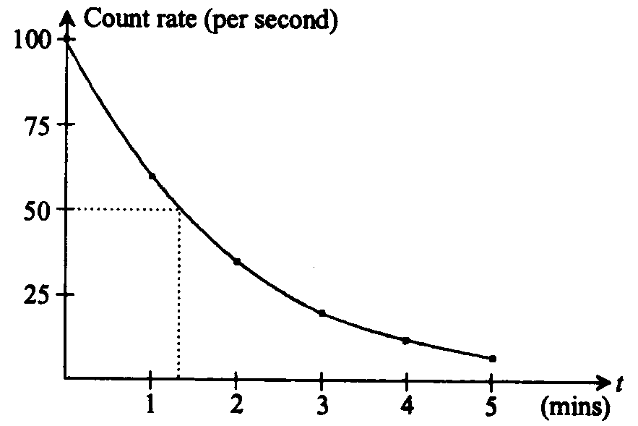
Example
From the graph, half life is ≈ 1.3mins.
After 6 half lives the activity A will be 1/2⁶th of the original activity.

Slide 29
Example
Terbrium-160 ¹⁶⁰Tb₆₅ decays via beta minus decay with a half life of 73 days. In a given sample there are 4.0 x 10¹⁸ atoms of terbrium-160. Write an equation for this decay and determine the number of terbrium-160 nuclei remaining after 1 year (365 days).

Slide 30
Example
Terbrium-160 ¹⁶⁰Tb₆₅ decays via beta minus decay with a half life of 73 days. In a given sample there are 4.0 x 10¹⁸ atoms of terbrium-160. Write an equation for this decay and determine the number of terbrium-160 nuclei remaining after 1 year (365 days).
γ
If you don’t know the name of a symbol Use an X (i.e. – instead of Dy)
365 days = 5 half lives ∴No. of nuclei remaining

Slide 31
Carbon Dating
Most naturally occurring radio-isotopes either:
have very long half-lives comparable with the age of the Earth, e.g.,
(2) are members of a chain of radio-isotopes produced as a heavy parent such as
(3) are produced continually by nuclear reactions occurring when cosmic rays interact with "earthly" atoms eg,

Slide 32
Carbon Dating
The isotope ¹⁴C₆ is used for radioactive dating.
It enables the age of very old materials made of previously living matter such as wood, to be found.
Carbon-14 is produced when a neutron collides with an atmospheric nucleus of nitrogen-14.

Slide 33
Carbon Dating
All living plants absorb CO₂ from the air and the majority of ¹²C₆ atoms transformed by the plants into organic tissues in their structure, and are stable .
Animals eat the plants and also use these carbon atoms.
Some of the C atoms in all living materials will not be ¹²C₆ but ¹⁴C₆ .
The ratio of ¹²C₆ : ¹⁴C₆ in the atmosphere has remained almost constant for several millennia and hence the ratio of these isotopes in living material will have a constant value.
The decay of ¹⁴C₆ is represented by the equation,

Slide 34
Carbon Dating
When a plant or an animal dies, carbon is no longer being processed.
The ratio of C-14 to C-12 therefore drops and after about 5730 year will be only ½ of its original value.
Example: An old wooden artifact was found in which the ratio of C-14 : C-12 was found to be only 25% of that measured in living tissue. About how old is the artifact?
Answer: 25% = ¼ = ½ × ½
i.e. two half-lives have elapsed and since T½ of C-14 is 5730 years, approximate age of the artifact is 5730 × 2 = 11460 years.

Slide 35
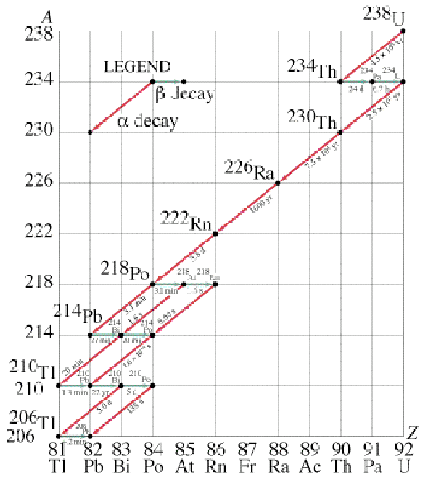
Uranium-lead Dating
of U-238 : lead 206 in a geological sample can be used to estimate the age of the sample. The radioactive decay series for U-238 is illustrated in the diagram
below;

Slide 36
Uranium-lead Dating
When molten materials, present when the Earth formed, solidified into rock, due to falling temperatures, different compounds had different melting points and separated to some extent.
U-238 nuclei were fixed, as were its daughters (grand-daughters and great- grand-daughters etc) were also fixed. Hence measuring the ratio of amount of U-238:amount of daughters enabled the time since the rock solidified to be determined.

Slide 37
Some Properties of Radioactive Emissions
The penetration of radiation through matter depends on the mass (or mass equivalence in the case of gamma radiation) and charge.
The alpha particle has the largest mass and charge, therefore it has the lowest rate of penetration.
The gamma radiation having no charge and as a high-energy photon has the greatest rate of penetration.
The order of increasing penetration is
alpha, beta positive, beta negative, neutron, gamma.

Slide 38
Some Properties of Radioactive Emissions
particle | penetration in air
α alpha | few mm
β⁺ positron | few mm in dense matter
β⁻ electron | 10 - 20 cm
γ gamma | 10 - 20 m

Slide 39
Some Properties of Radioactive Emissions
The nature of the radiation can be detected by its passage through a cloud or bubble chamber when in the presence of a uniform magnetic field.
We use the right hand rule to determine the charge on the particle and using the length of track produced, the type of particle can be identified.
A
B
A - α particle (not much penetration)
B - γ ray photon (no deflection)
C - β⁻ particle (large penetration)
C

Slide 40
Some Properties of Radioactive Emissions
The penetration of radiation through matter depends on the mass (or mass equivalence in the case of gamma radiation) and charge.
The alpha particle has the largest mass and charge, therefore it has the lowest rate of penetration.
The gamma radiation having no charge and as a high-energy photon has the greatest rate of penetration.
The order of increasing penetration is
alpha, beta positive, beta negative, neutron, gamma.

Slide 41
Some Properties of Radioactive Emissions
particle | penetration in air
α alpha | few mm
β⁺ positron | few mm in dense matter
β⁻ electron | 10 - 20 cm
γ gamma | 10 - 20 m

Slide 42
Some Properties of Radioactive Emissions
The nature of the radiation can be detected by its passage through a cloud or bubble chamber when in the presence of a uniform magnetic field.
We use the right hand rule to determine the charge on the particle and using the length of track produced, the type of particle can be identified.
A
B
A - α particle (not much penetration)
B - γ ray photon (no deflection)
C - β⁻ particle (large penetration)
C

Slide 43
The Effects of Ionising Radiation on Living Matter
In addition to alpha, beta, and gamma, other radiations, including X-rays, neutrons, and protons, cause ionisation in matter. They are collectively called ‘ionising radiation’.
Ionising radiation can break chemical bonds in living matter, and this can kill cells. It can also change the genetic material in cells.

Slide 44
The Effects of Ionising Radiation on Living Matter
Health aspects of radioactivity
Nuclear radiations pose a health hazard because of the damage they cause to tissue. The nuclear radiations have two effects on biological tissue:
(i) their ionising ability breaks chemical bonds. This causes the rupture of cell walls and damage to cell function. These effects are similar to those caused by burns.
(ii) they can cause damage in a similar way to the genetic material in cells. In the longer term this can cause cancer and deformity.

Slide 45
The Effects of Ionising Radiation on Living Matter
Radiation damage is more severe if you are close to the source.
This is especially so if the radioactive material is inside the body. Hence ingestion of contaminated food, smoke, air etc. is particularly dangerous.
Radioactive sources are therefore often completely sealed to remove the risk of contamination. If unsealed sources are used small amounts of active material may remain on surfaces. For this reason eating, smoking, or putting anything in the mouth should be forbidden in the presence of contamination hazards.

Slide 46
The Effects of Ionising Radiation on Living Matter
Dosages of Nuclear Radiation to Humans
Quantitative measurement of nuclear radiation involves two types of units, those units which measure physical nuclear radiation itself and those units which measure the biological effect of nuclear radiation.
Physical radiation units measure the activity of a source of radiation. The SI unit of physical nuclear radiation is the becquerel (Bq). A radiation source with an activity of one becquerel has one disintegration per second. An older unit of physical nuclear radiation which is still widely used is the curie (Ci).

Slide 47
Positron Emission Tomography
Can replace stable elements in the body with a radioactive substitute.
Flourine-18 (radioactive) replaces Flourine-19 in the body and can be traced as it enters tissue.

Slide 48
Positron Emission Tomography
Positron-Electron Annihilation
    When a radioactive isotope decays by β-plus decay, the collision of the emmitted positron with an electron results in the creation of two identical gamma ray photons travelling in opposite directions. Ie

Slide 49
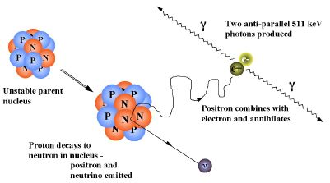
Positron Emission Tomography

Slide 50
Positron Emission Tomography
Positrons are emitted during the decay of Flourine-18.
Travels approximately 1mm before it has lost nearly all of its energy.
When the energy is low enough, it is able to collide with an electron in the tissue in a process called positron-electron annihilation.
2 Gamma ray photons are produced which travel of at 180 degrees to each other.

Slide 51
Positron Emission Tomography
Calculation of the energy of the photons.
The energy of the photons can be determined by the following.
The total mass of the electron and the positron is twice the mass of an electron, ie (2m_{e}).
Therefore, the energy of each photon is 511 keV.

Slide 52
Positron Emission Tomography
Formation of the Image
The PET analysis uses a scanner that detects the emitted gamma ray photons.
The scanner consists of a ring detectors placed around the body that detect all of the emitted gamma ray photons. A computer uses this information to display an image.
Active sites in tissue, such as cancer, will absorb large amounts of radio-isotopes and the PET scanner will show these as Hot Spots where the body processes are active.
This can aid in the early detection if cancer.
Because the annihilation occurs with in 1mm of the decay, the PET scanner can precisely pinpoint the area in question.

Slide 53
Positron Emission Tomography
Some radio-isotopes used in PET Scanners.
Oxygen-15 is constituted into water and then used to monitor blood flow through a tissue.

Slide 54
Positron Emission Tomography
Some radio-isotopes used in PET Scanners.
Flourine-18 is attached to glucose molecules. This is used to follow brain function, both healthy and diseased and is also used to monitor the function of the heart muscle.

Slide 55
Positron Emission Tomography
Location of PET scanners
One limitation of this technology is that it must be placed close to a cyclotron. This can be very costly have both nearby. This is necessary because the isotopes in questions have very short half lives and the transport time may only leave a small amount of radio active substance left to use.
The radio isotopes must be used with in the first few half lives if a high quality image is to be produced.

