Slide 1
Radioactive decay

Slide 2
SACE says
“Unstable nuclei will undergo radioactive decay in which particles and/or electromagnetic radiation are emitted.”
But, what does that all mean?
Lets have a wander ... (right back to the start)

Slide 3
nuclei
Nuclei is the plural of nucleus, the centre of an atom
Atoms;
A unit of matter; the smallest unit of a chemical element. Each atom consists of a nucleus, which has a positive charge, and a set of electrons that move around the nucleus. (dictionary.com)
Atoms have zero charge (number of protons = number of electrons)

Slide 4
Atoms are …
Made of Protons and Neutrons in the Nucleus with Electrons in energy levels around it.
Protons and Neutrons are made of quarks, a fundamental particle
Fundamental means it is not made of other particles, not that in cannot be created or decay

Slide 5
So what is an ‘unstable nucleus’ ?
In simple terms, it is any nucleus that will spontaneously decay.
Some isotopes like ${He}^{2}$(no neutrons) have a half life of ${10}^{−9}seconds$, Uranium 236 $U^{236}$has a half life of $2×{10}^{7}years$, both are considered “unstable”
Remember, half life is how long it takes for half of the sample to decay.

Slide 6
Radioactive Decay
Radioactive decay (also known as nuclear decay, radioactivity, radioactive disintegration or nuclear disintegration) is the process by which an unstable atomic nucleus loses energy by radiation. A material containing unstable nuclei is considered radioactive. (Wikipedia)

Slide 7
NOTE …
Radioactive decay is all about ‘losing energy by radiation’
NOT becoming somethings else or breaking up

Slide 8
Recap
Radiation. The most common form of radiation is Electromagnetic Radiation.
Visible light is part of the spectrum of Electromagnetic Radiation. So is gamma radiation, microwave radiation, radio waves, etc.

Slide 9
There are 3 other ‘common’ types of radiation
Alpha
Beta plus
Beta minus
In Alpha decay, a nucleus spontaneously emits an alpha particle (2 protons and 2 neutrons). Equal to a helium nucleus.

Slide 10
Beta decay (be careful)
Beta minus decay
the nucleus emits an electron and an antineutrino in a process that changes a neutron to a proton
Beta plus decay
the nucleus emits a positron and a neutrino in a process that changes a proton to a neutron (also known as positron emission).

Slide 11
Sound familiar? – weak force interaction
A Neutrino passes close to a neutron in an unstable isotope and;
Becomes a $W^{+}$ boson and an electron
The $W^{+}$ boson interacts with a down quark in the nucleus and changes it into an up quark.
An anti neutrino is created in the interaction to conserve spin and energy

Slide 12
So …
$W^{+}$boson is the weak force particle in Beta minus decay
Yes read that again ..
And
$W^{−}$boson is the weak force particle in Beta plus decay

Slide 13
But there is more …
Neutron Emission
extremely neutron-rich nuclei, lose energy by way of neutron emission, resulting in a change from one isotope to another of the same element.
Electron Capture
the nucleus captures an orbiting electron, causing a proton to convert into a neutron in a process. A neutrino and a gamma ray is subsequently emitted.
Cluster Decay and Nuclear Fission
a nucleus heavier than an alpha particle is emitted.

Slide 14
Summary time
Radioactive decay is where atoms decay (lose energy) either through;
Alpha decay
Beta⁺ or Beta– decay
Neutron Emission
Electron Capture
Cluster Decay and Nuclear Fission

Slide 15
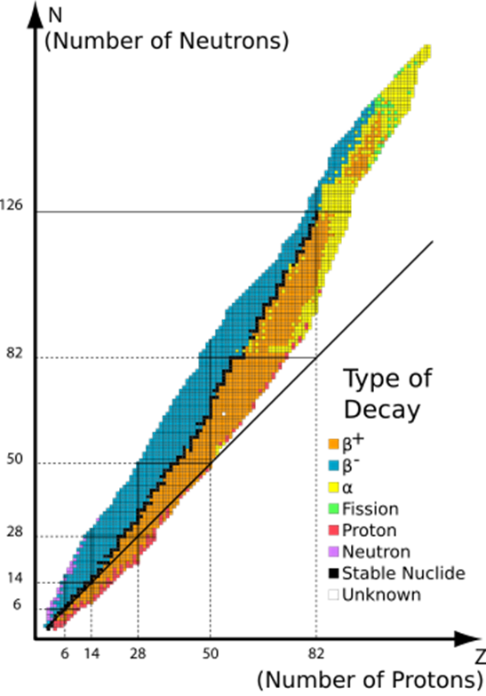
NZ Graph

