Slide 1
Motion under constant acceleration
Stage 1 physics

Slide 2

Equations work with
Displacement (not distance) $\vec{s}$
Velocity (not speed) $\vec{v}$
Acceleration $\vec{a}$

Slide 3
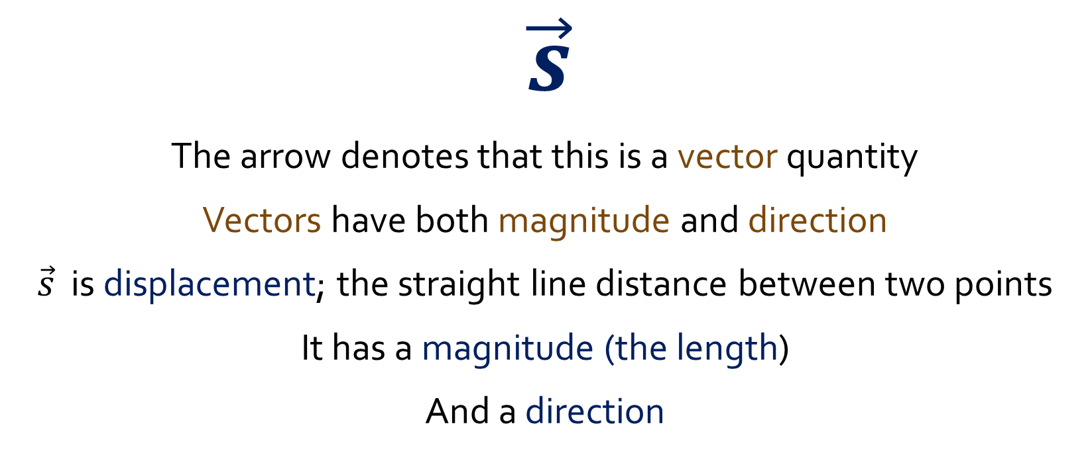
The ‘arrow’
$\vec{s}$
The arrow denotes that this is a vector quantity
Vectors have both magnitude and direction
$\vec{s}$ is displacement; the straight line distance between two points
It has a magnitude (the length)
And a direction

Slide 4
Scalars vs Vectors
Scalar | Vector
Distance | Displacement
Speed | Velocity

Slide 5
Speed (scalar)
Speed vs Average Speed
  At any point as you drive to Melbourne, your speed (according to your speedo) may reach 110kph
  However, when you get to Melbourne and calculate your average speed (based on total distance covered divided by total time taken), you may find the average speed is only 90kph
  Note; speed and average speed are scalars and therefore do not have a direction

Slide 6
Velocity (vector)
Velocity vs Instantaneous Velocity
  At any point as you drive to Melbourne, your Instantaneous Velocity (according to your speedo AND a compass) may be 30.6ms⁻¹ to the East
  However, when you get to Melbourne and calculate your velocity (based on the displacement of Melbourne From Adelaide divided by change in time from start to finish), you may find the velocity is 25ms⁻¹
  Note; we use quite different terminology between speed and velocity.

Slide 7

The starting point
The definition of average velocity
$\vec{v}=\frac{∆s}{∆t}=\frac{v_{0}+v}{2}$
The definition of average acceleration
$$\vec{a}=\frac{∆v}{∆t}=\frac{v−v_{0}}{∆t}$$

Slide 8
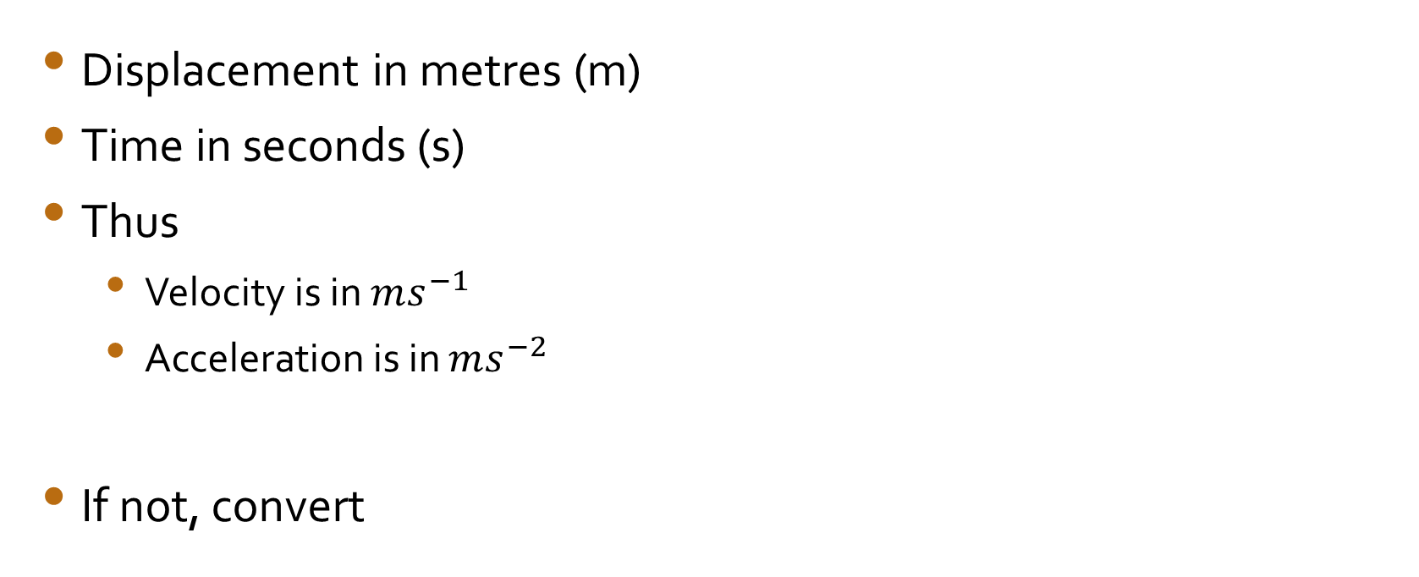
Always use SI units
Displacement in metres (m)
Time in seconds (s)
Thus
  Velocity is in $ms^{−1}$
  Acceleration is in $ms^{−2}$
If not, convert

Slide 9
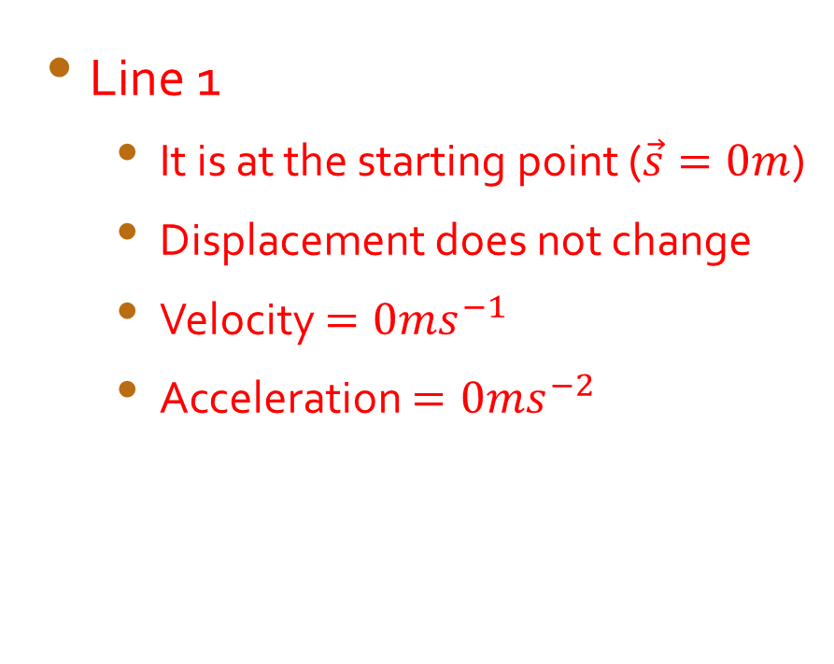
Graphic representations (s/t graph)
Line 1
  It is at the starting point ($\vec{s}=0m$)
  Displacement does not change
  Velocity $=0ms^{−1}$
  Acceleration $=0ms^{−2}$

Slide 10
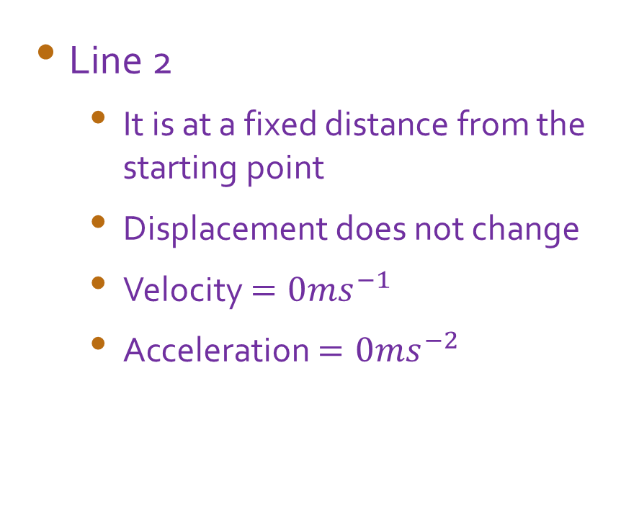
Graphic representations (s/t graph)
Line 2
  It is at a fixed distance from the starting point
  Displacement does not change
  Velocity $=0ms^{−1}$
  Acceleration $=0ms^{−2}$

Slide 11
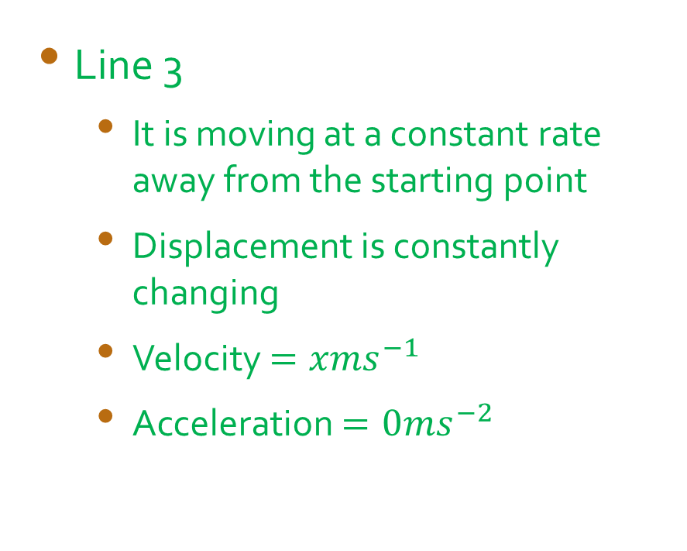
Graphic representations (s/t graph)
Line 3
  It is moving at a constant rate away from the starting point
  Displacement is constantly changing
  Velocity $=xms^{−1}$
  Acceleration $=0ms^{−2}$

Slide 12
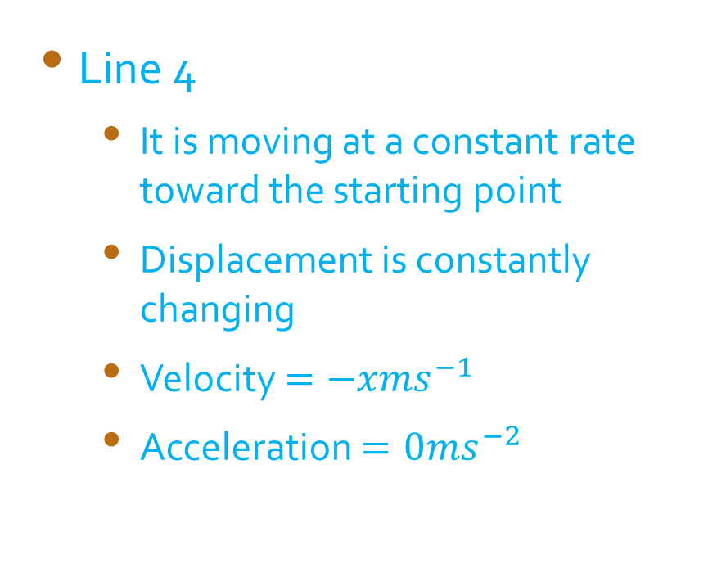
Graphic representations (s/t graph)
Line 4
  It is moving at a constant rate toward the starting point
  Displacement is constantly changing
  Velocity $=−xms^{−1}$
  Acceleration $=0ms^{−2}$

Slide 13
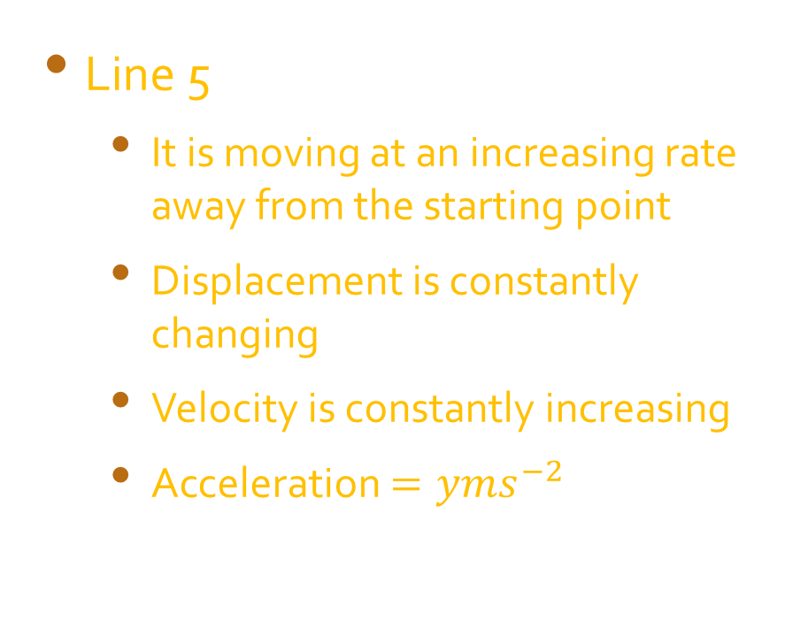
Graphic representations (s/t graph)
Line 5
  It is moving at an increasing rate away from the starting point
  Displacement is constantly changing
  Velocity is constantly increasing
  Acceleration $=yms^{−2}$

Slide 14
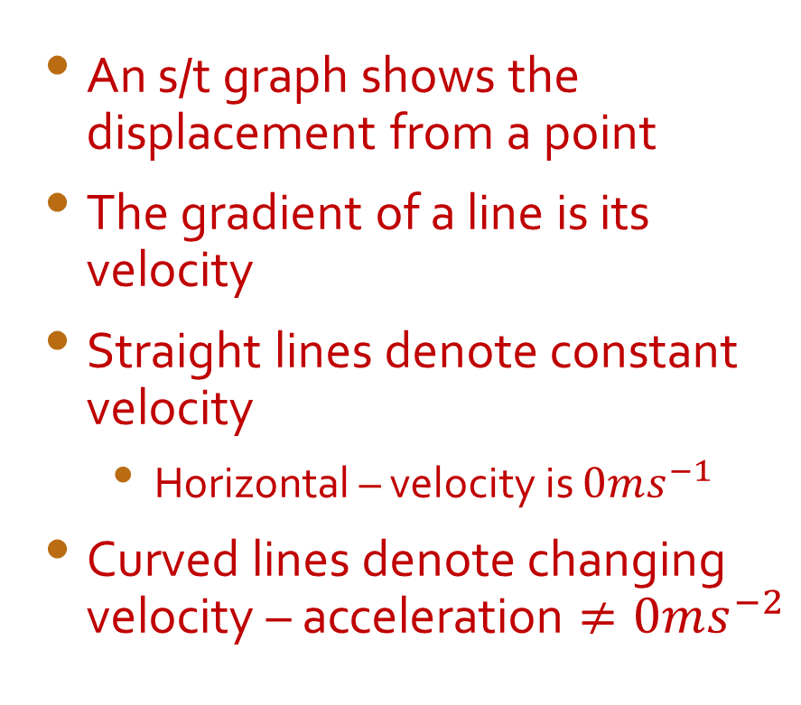
The s/t graph
An s/t graph shows the displacement from a point
The gradient of a line is its velocity
Straight lines denote constant velocity
  Horizontal – velocity is $0ms^{−1}$
Curved lines denote changing velocity – acceleration $≠0ms^{−2}$

Slide 15
Break

Slide 16
The velocity / time graph
Note; This is a new graph. We are now plotting velocity verses time for an object.

Slide 17
The v/t graph
Line 1
  Velocity is zero
  Acceleration is zero
  Note; this does not tell you “where” the object is, only that it is currently stationary

Slide 18
The v/t graph
Line 2
  Velocity is constant and positive
  Acceleration is zero
  Note; Again this does not tell you “where” the object is, only that it is currently moving with a constant velocity

Slide 19
The v/t graph
Line 3
  The velocity is steadily increasing from rest
  Acceleration is positive and constant
  Note; Again this does not tell you “where” the object is, only that it is currently moving with an increasing velocity

Slide 20
The v/t graph
Line 4
  The velocity is steadily decreasing to rest
  Acceleration is negative and constant
  Note; Again this does not tell you “where” the object is, only that it is currently moving with an decreasing velocity

Slide 21
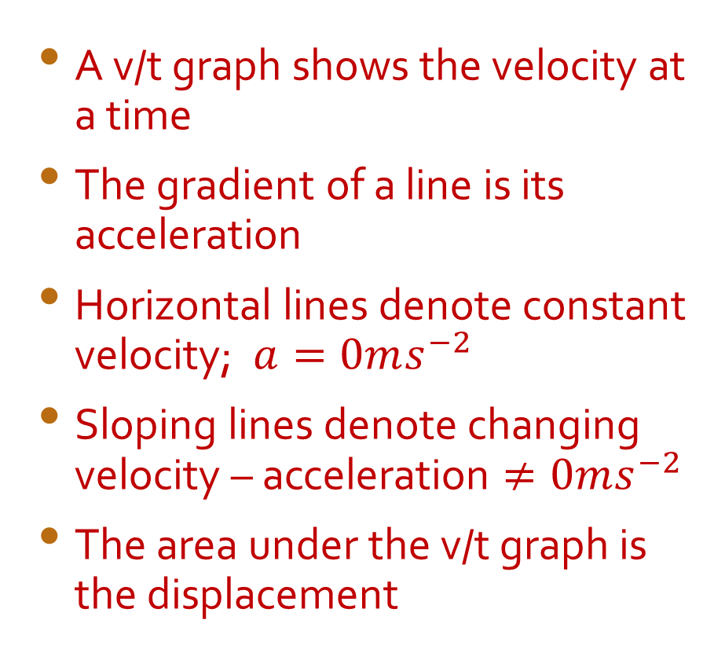
The v/t graph
A v/t graph shows the velocity at a time
The gradient of a line is its acceleration
Horizontal lines denote constant velocity; $a=0ms^{−2}$
Sloping lines denote changing velocity – acceleration $≠0ms^{−2}$
The area under the v/t graph is the displacement

Slide 22
Recap on slope
The slope of the s/t graph is velocity
The slope of the v/t graph is acceleration
And the area under the v/t graph is displacement
And ….the area under an a/t graph is the velocity change in that time period

Slide 23
Time for another break

Slide 24
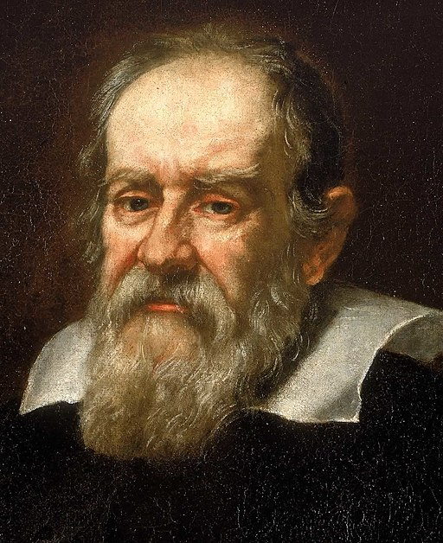
Galileo
Though working before Newton was born, Galileo Galilei was one of the great contributors to our understanding of classical physics and astronomy. His work also underpins much of Einstein’s theories of relativity.
He is also attributed with the 3 main equations of motion for bodies with uniform acceleration.

Slide 25
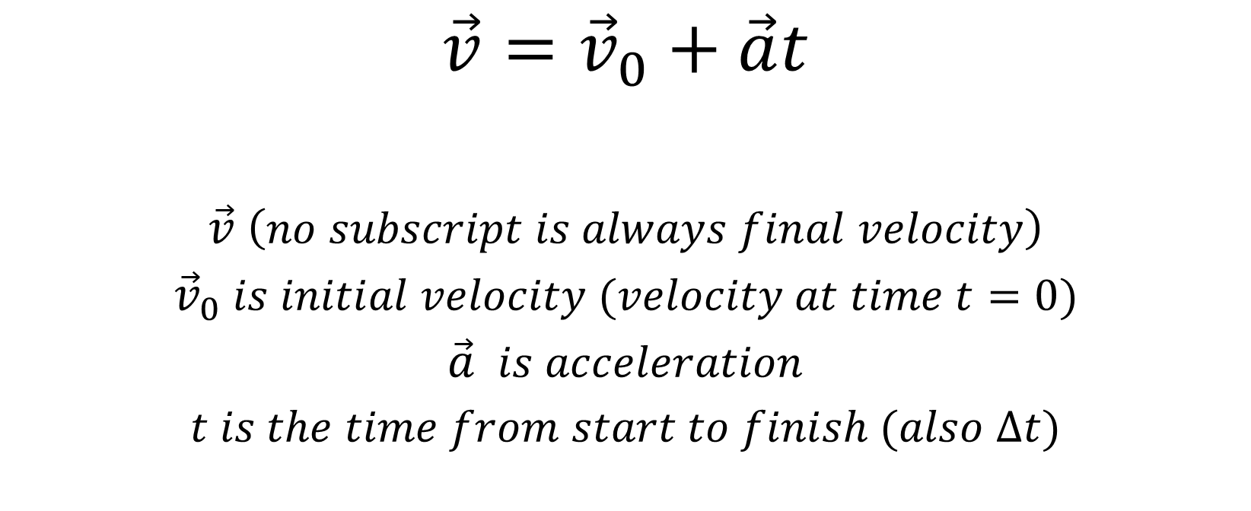
Equation 1
$$\vec{v}={\vec{v}}_{0}+\vec{a}t$$
$$\vec{v} \left(no subscript is always final velocity\right)$$
$${\vec{v}}_{0} is initial velocity (velocity at time t=0)$$
$$\vec{a} is acceleration$$
$$t is the time from start to finish (also ∆t)$$

Slide 26
Example without re-arrangement
John’s dog is running at 3ms⁻¹ when it accelerates after a cat at 2ms⁻² for 3 seconds.
What is its final velocity?

Slide 27
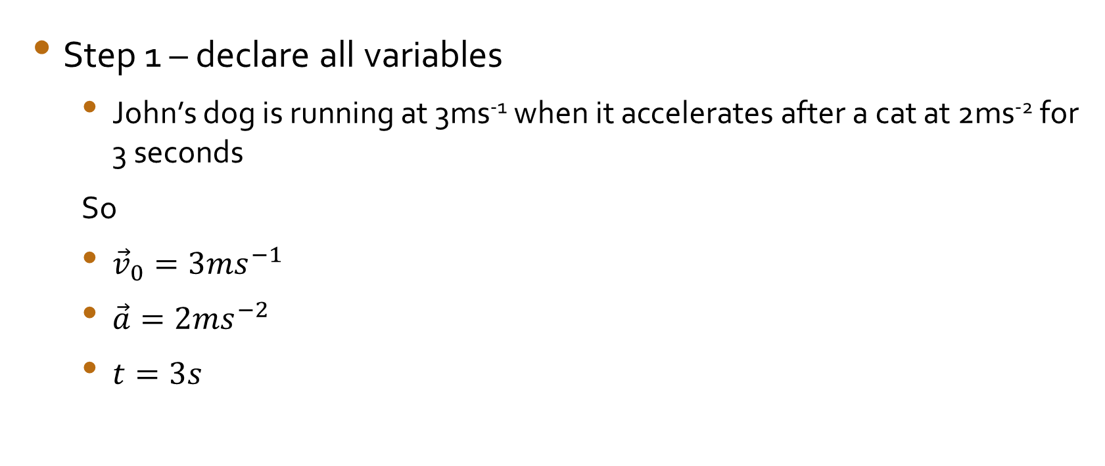
Solution structure
Step 1 – declare all variables
  John’s dog is running at 3ms⁻¹ when it accelerates after a cat at 2ms⁻² for 3 seconds
  So
  ${\vec{v}}_{0}=3ms^{−1}$
  $\vec{a}=2ms^{−2}$
  $t=3s$

Slide 28
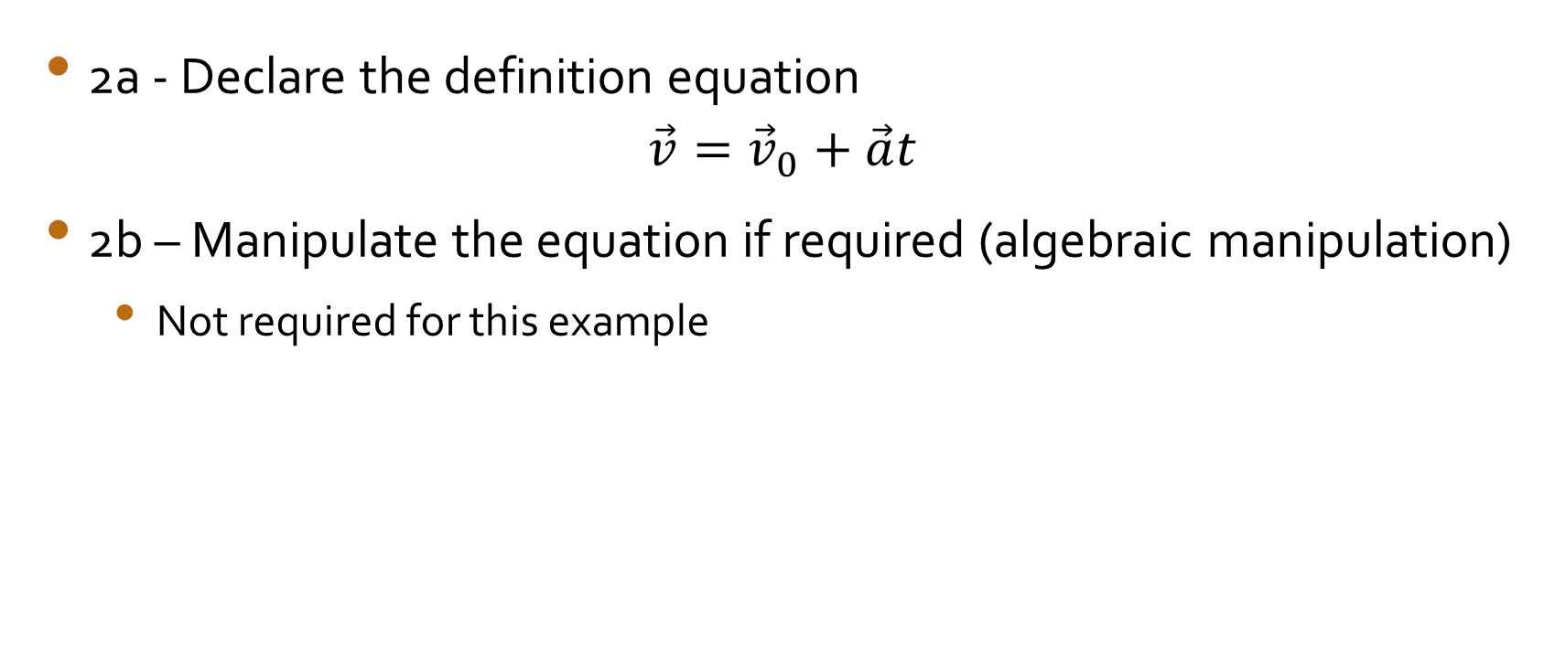
Solution structure 2
2a - Declare the definition equation
$$\vec{v}={\vec{v}}_{0}+\vec{a}t$$
2b – Manipulate the equation if required (algebraic manipulation)
  Not required for this example

Slide 29
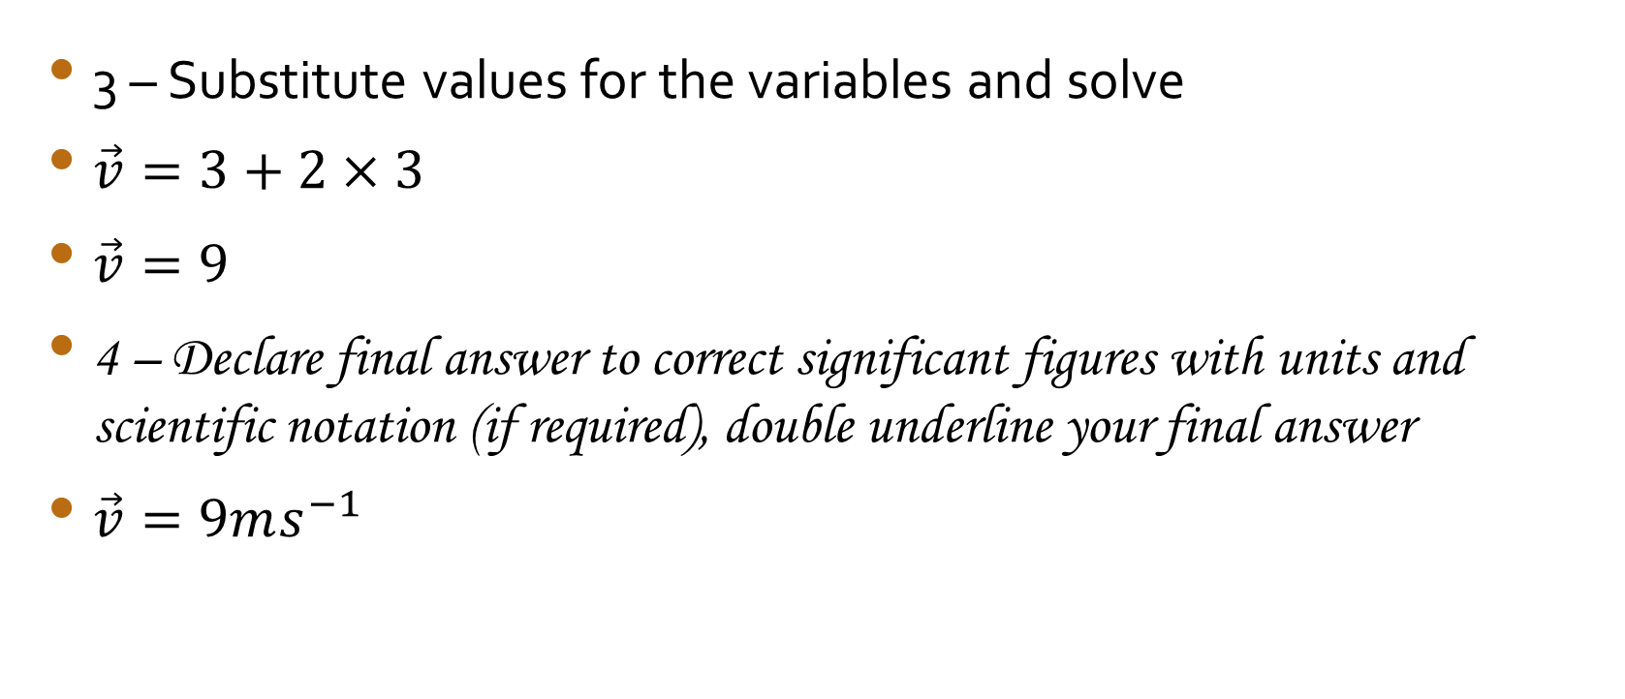
Solution structure 3
3 – Substitute values for the variables and solve
$\vec{v}=3+2×3$
$\vec{v}=9$
4 – Declare final answer to correct significant figures with units and scientific notation (if required), double underline your final answer
$\vec{v}=9ms^{−1}$

Slide 30
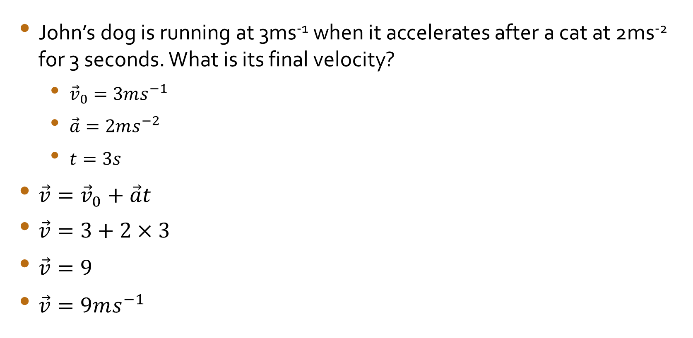
Solution without notation
John’s dog is running at 3ms⁻¹ when it accelerates after a cat at 2ms⁻² for 3 seconds. What is its final velocity?
  ${\vec{v}}_{0}=3ms^{−1}$
  $\vec{a}=2ms^{−2}$
  $t=3s$
$\vec{v}={\vec{v}}_{0}+\vec{a}t$
$\vec{v}=3+2×3$
$\vec{v}=9$
$\vec{v}=9ms^{−1}$

Slide 31
Example with re-arrangement
A shopping trolley gets away from a customer, rolling down a hill and hitting a wall at 12ms⁻¹. If it rolls for 3 seconds before hitting the wall and was going at 2ms⁻¹. what was its acceleration?

Slide 32

The solution
  ${\vec{v}}_{0}=2ms^{−1}$
  $\vec{v}=12ms^{−1}$
  $t=3s$
$\vec{v}={\vec{v}}_{0}+\vec{a}t$
New step – manipulate or re-arrange the equation (do the algebra)
$\vec{a}t=\vec{v}−{\vec{v}}_{0}$
$∴\vec{a}=\frac{\vec{v}−{\vec{v}}_{0}}{t}$
$∴\vec{a}=\frac{12−2}{3}$
$\vec{a}=3.33$
$\vec{a}=3ms^{−2}$
Note the significant figures; since the question gives only a certainty of 1 sig fig, so should the final answer

Slide 33
Significant figures note
Always give final answer to the least number of significant figures given in the question
Always give second last line of the solution to sig figs + 2
Always calculate to sig figs + 2

Slide 34

Equation 2
$$\vec{s}={\vec{v}}_{0}t+\frac{1}{2}\vec{a}t^{2}$$
$$\vec{s} is the displacement;the straight line distance between the starting and finishing points.$$

Slide 35
Example without rearrangement
What is the displacement of a car over 5 seconds if it was going at 3ms⁻¹ initially and then accelerated for the 5 seconds at 3ms⁻²?

Slide 36
Example with rearrangement
How long has a ball been falling if it was dropped and when observed by a teacher who is 4 stories below the student who dropped it? Each story is 3m high.

Slide 37

Equation 3
$${\vec{v}}^{2}=\vec{v}0^{2}+2\vec{a}\vec{s}$$

Slide 38
Example without rearrangement
What is the velocity of a car that has accelerated for 20m at 3ms⁻², having been rolling at 4ms⁻¹ at the time you first observed it?

Slide 39
Example with re-arrangement
What distance has a rock fallen if when you see it, it is falling at 290ms⁻¹

Slide 40

The 3 Equations of Motion
$$\vec{v}={\vec{v}}_{0}+\vec{a}t$$
$$\vec{s}={\vec{v}}_{0}t+\frac{1}{2}\vec{a}t^{2}$$
$${\vec{v}}^{2}=\vec{v}0^{2}+2\vec{a}\vec{s}$$

