Slide 1
Stage 1 Physics
Semester 1 Introduction

Slide 2
The universe
Small stuff – just energy
Big stuff – also just energy
Bits in between – lots of energy
It would be possible to describe the universe with only two concepts; Energy and Momentum
In fact, controversial as it is, that is what we are going to do.

Slide 3
Course summary (not really)
Small stuff is just energy
  Consider: when we add atoms together to get molecules stuff happens.
  We call this stuff chemical reactions
    “okay”, there are also nuclear reactions (fusion and fission) and we will get to them, but we have to walk before we run
  The classic chemical reaction is the joining of hydrogen and oxygen
  A gentle, relaxed reaction ….

Slide 4
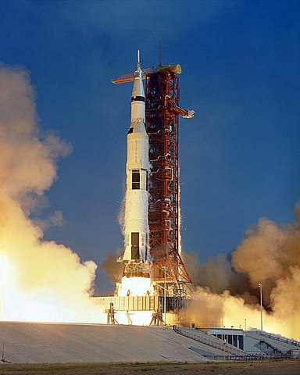
Water
That white stuff coming out of the bottom of the rocket is water.
  Water and energy (that is all).
  When we bring hydrogen and oxygen together, they really, really, really want to be together.
  How ‘badly’ they want to be together is shown by the amount of energy they ‘get rid of’ when they can be together.
  By themselves Hydrogen (H₂) and Oxygen (O₂) are in high energy states.
  Bring them together and they form water (a lower energy state molecule)
Image courtesy NASA, Public domain, via Wikimedia Commons

Slide 5
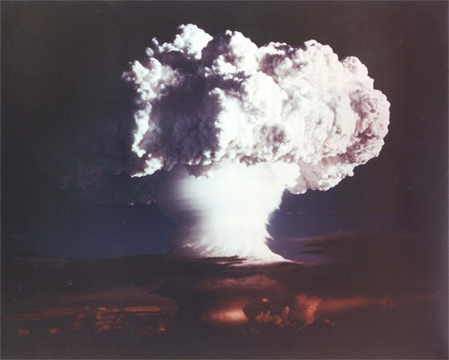
But .. What if we force two hydrogen atoms to get really, really close?
Well, that is where we get the sun, or H bombs.
Note:
  The final product is lighter than the reactants
  The mass difference (Mass Defect) is seen as energy
Ivy Mike H bomb – image courtesy US department of energy

Slide 6
Terminology recap
Bring stuff together and get fire (or an explosion)
This is combustion (a chemical reaction); The new configuration of the stuff requires less energy than the old. The “left over” energy comes out as heat (flame, fire)
Note: the individual atoms have not changed H is still H, O is still O
Bring stuff together such that they form new atoms
This is fusion (a nuclear reaction); The new stuff is a new atom. In the case of the sun we go from H to He losing mass in each step. The left over mass becomes energy
Note: the atoms have changed

Slide 7
Summary so far
Bring stuff together and we get energy
Bring stuff really, really, really close together and we get energy and we lose mass (we end up with less ‘stuff’)
But, there is something even weirder
Smallering (not a technical term) results in less stuff and that reduction in stuff becomes energy

Slide 8
Lets rip an atom apart (don’t do this at home)
Atoms are made up of;
  Protons
  Neutrons
  Electrons
  Add the individual mass of all three together and it is more than the final atom
    Thus, by coming together, it gets smaller

Slide 9
But, there is more
Take a Proton
Protons are made of Quarks
Protons are made of an average of three Quarks
Three Quarks have a mass less than 1000th of a Proton
    Yes, you read that correctly
Neutrons are also made up of 3 Quarks (and an Electron, but we will explain that later also)

Slide 10
Where is the rest of the mass?
It is found in the energy of the proton or neutron
You will have to wait for later in the year, but in brief
Everything at the atomic level has the “zoomies”
But you will have noticed that you and everything around you is not exploding as it “zooms” apart.
The energy in the atomic particles is holding everything together

Slide 11
What about the electron
Well, we cant find it
The more precise our instruments get, the smaller an electron seems to be
In the beginning we ‘chucked’ electrons at glass covered with sensitive film and the film flashed or got black spots and everyone was happy.
We then got to the stage that we could measure the momentum in an electron collision and we were happy
But as we ‘sharpen’ our sensors, we can find the energy and the momentum but not the “stuff”

Slide 12
Summary
A very brief, very bad summary
The more you bring things together, the lighter they are
The more you look into something, the less mass you find and the more energy

Slide 13
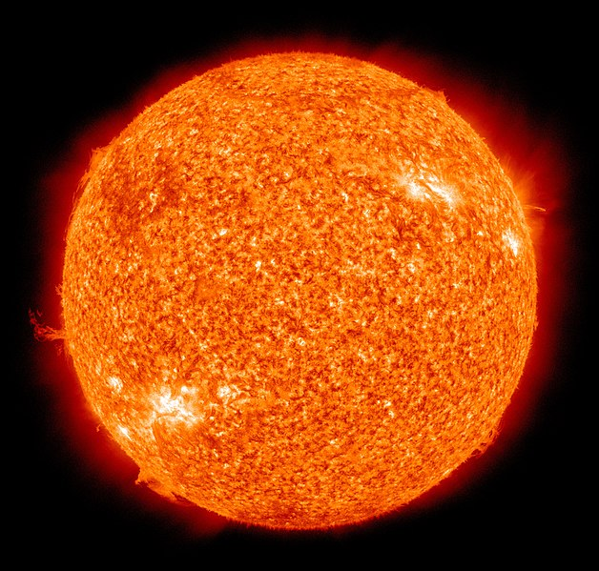
Big stuff
Lets not muck around, start with a supermassive star
When it burns out it collapses becoming a Neutron Star which continues to collapse, becoming a Black Hole
The original mass is all contained in a ‘singularity’ in the core (centre). Note; this is a mathematical singularity (mathematically 0 in all dimensions), however, it isn’t/can’t be zero, but there is no way we can know (now) exactly what its structure is
Our sun (not a supermassive star), image courtesy NASA.

Slide 14
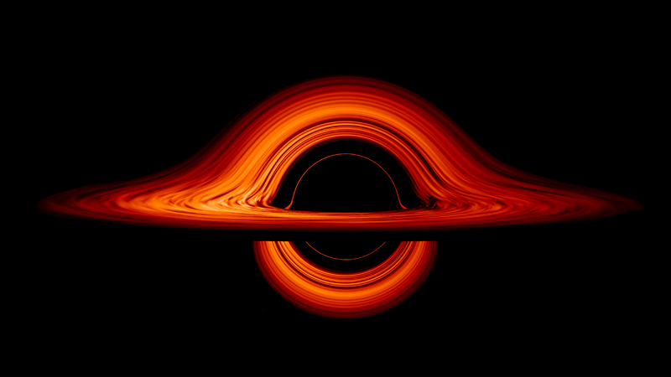
The Black Hole
The core of a black hole is tiny
The ‘size’ that defines its high level influence (the ‘no getting back out zone’), the Schwarzschild Radius is massively bigger than the core, but tiny compared to the original black hole
Its overall influence is enormous
  A Supermassive Black Hole holds the Milky Way together
An artists impression of a black hole (not a photo). Image courtesy NASA’s Goddard Space Flight Centre/Jeremy Schnittman, cmglee

Slide 15
Final summary
Small
Atomic forces (Potential and Kinetic Energy) keep everything together and are most of what we call mass
Large
Gravitational forces (Potential Energy) keep everything together in a universe that is mainly nothing

Slide 16
Final, final summary
Back to the course
At the end of this year we will have developed an understanding of energy and momentum
We will look a the energy in bodies and systems
We will see how momentum (Kinetic Energy), both linear and rotational is conserved and is a key part in understanding how everything interacts

