Slide 1
Fission and Fusion
Stage 1 Physics

Slide 2
Nuclear Fission
A process in which the nucleus of an atom splits into two or more smaller, lighter nuclei (called daughter nuclei).
It is a form of nuclear ‘transmutation’ where one element becomes a (or range of) different elements

Slide 3
Nuclear Fission – brief history
January 1934, Irène Joliot-Curie and Frédéric Joliot announced that they had bombarded elements with alpha particles and induced radioactivity in them.
February – March 1934- Enrico Fermi bombarded a range of elements with neutrons causing radioactive decay
Fermi went on to note radioactive decay in Uranium when bombarded with neutrons.

Slide 4
1938- Otto Hahn & Fritz Strassmann split U-235 into smaller nuclei.
1939- Lise Meitner theorized that splitting occurs when the nucleus becomes so unstable that it splits.
Thus we have the process of splitting a nucleus into smaller nuclei- nuclear fission

Slide 5
The fission of Uranium 235

Slide 6
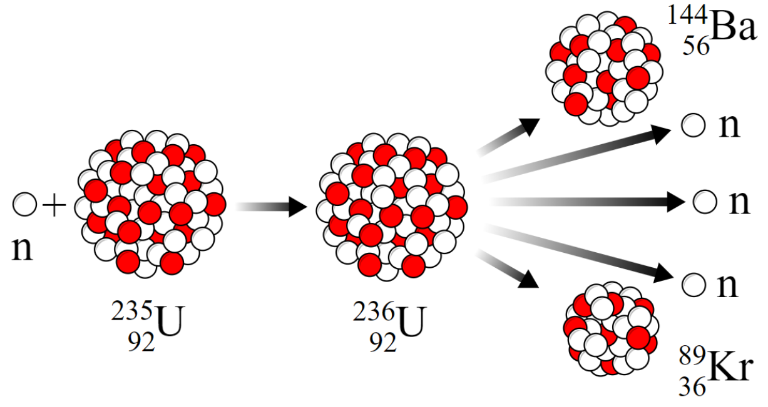
What nuclei can split during nuclear fission?
U-236 is so unstable that it immediately splits into barium & krypton nuclei, several neutrons & a large amount of energy

Slide 7
How are mass & energy related?
Henri Poincare proposed a paradox of mass and energy within atomic level interactions
Einstein proposed the equivalence of mass and energy due to the symmetry of space and time
In other words mass & energy are related & can be changed from one to the other.

Slide 8
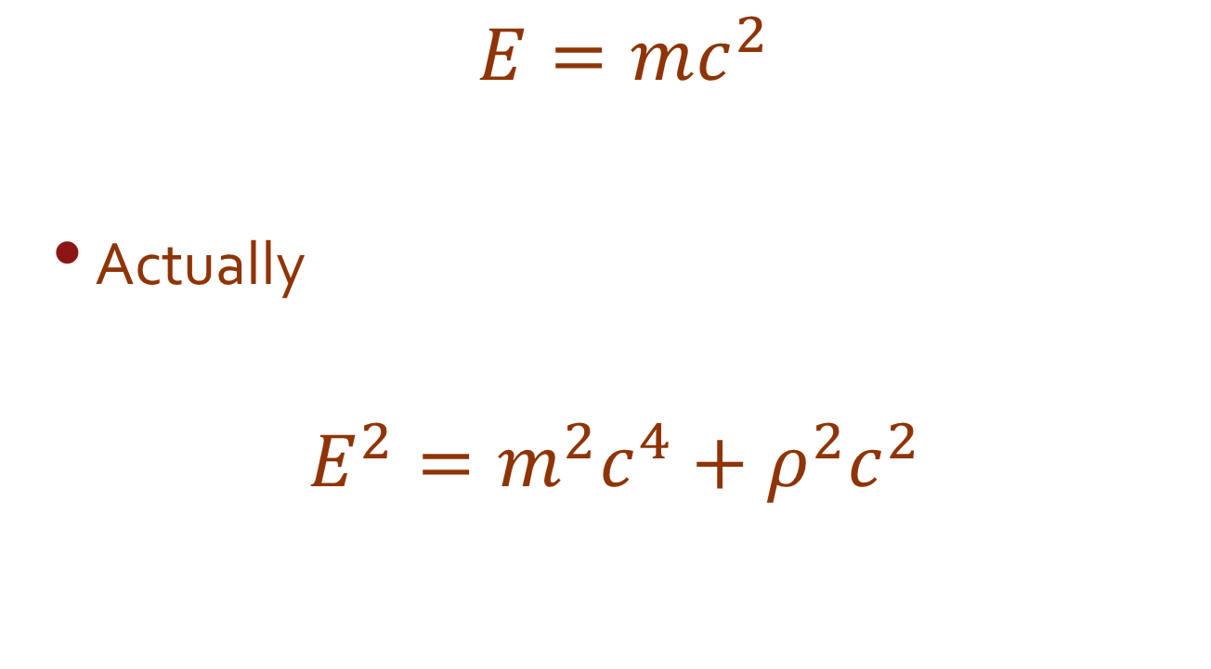
How are mass & energy related?
$$E=mc^{2}$$
Actually
$$E^{2}=m^{2}c^{4}+ρ^{2}c^{2}$$

Slide 9
How are mass & energy related?
Einstein proposed that mass & energy are related & can be changed from one to the other.
His special theory of relativity says;
$$E_{(joules)}=m_{(kg)}c^{2}$$

Slide 10
What is a chain reaction?
Free neutrons produced by fission can hit other nuclei emitting more neutrons repeating the reaction over and over.
Since each fission produces 3 neutrons, each fission step can triple the number of reactions.
A series of fission reactions is called a chain reaction.

Slide 11
Terminology
An isotope that is unstable and likely to undergo fission is called fissile.
A series of fission reactions is called a chain reaction.
Critical mass relates to having so much fissile material that every fission reactions will produce more than 1 new reaction.
Critical mass is normally only used when talking about nuclear bombs, not power creation.

Slide 12
Nuclear Fission
Splitting one nucleus of U-235/U-236 releases about 30 million times more energy than when one molecule of dynamite explodes.

Slide 13
Nuclear Fusion
In a nuclear fusion reaction, two small, light nuclei combine to form one larger, heavier nucleus.
Fusion combines nuclei & Fission splits them apart.

Slide 14
How are temperature & fusion related?
How can two nuclei get close enough to combine?
They must be moving very fast.
All nuclei positively charged and thus repel each other ($F=\frac{1}{4πε_{0}}×\frac{q_{1}q_{2}}{r^{2}}$)
Their kinetic Energy $E_{k}$ must overcome the electrostatic repulsion force to push them close enough to combine
$E_{k}$ increases as temperature increases
Temp must be millions of °C (stellar values)

Slide 15
How does the Sun produce energy?

Slide 16
Or

Slide 17
Fusion on the Sun
The heat & light Earth receives comes from this process.
About 1% of the Sun’s Hydrogen has been changed into energy.
Sun has enough Hydrogen to continue fusion reactions for another 5 billion years.

